Slide 1

The world of investments –
An alternative view
Finance & Investment Forum
12th November 2015

Slide 2


Confidential
Managing Wealth in Retirement
A Presentation to the Society of Actuaries in Ireland
November 2015
Adam Cleland, ACA, CTA, CFA, QFA
Head of Wealth Advice
Davy

Slide 3




The backdrop

Slide 4
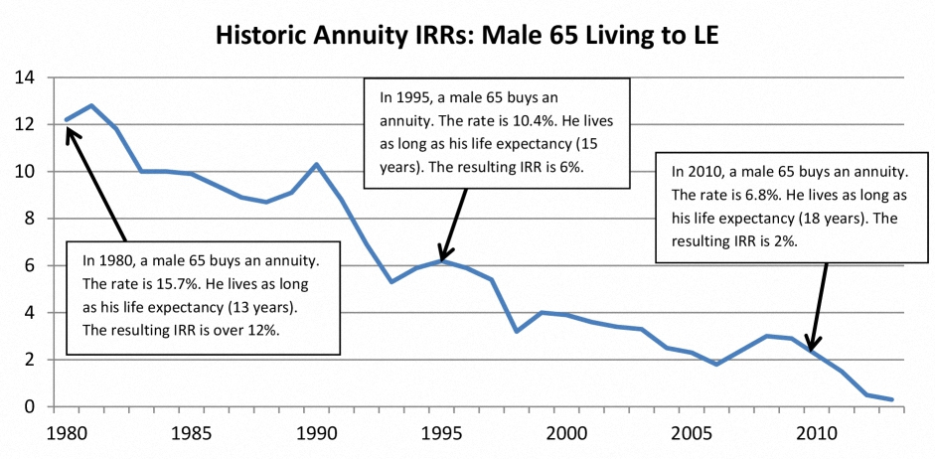
The trigger
Source: www.the7circles.uk
Notes:
Interestingly, those who study this type of data used to think that by the time people got to age 65, they would not advance very much in terms of longevity because there is only so long that a human body can live. Every generation of scientists says the same thing, and every generation of scientists has been wrong during the 20th century. The consistent increase in longevity is essentially linear.
Large difference between Healthy and Wealthy and Poor and Unhealthy. Down not to genetics but lifestyle (education, diet exercise) shows no sign of dimishing.

Slide 5

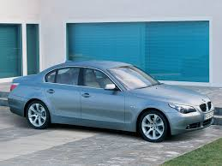




The trigger 2
Number of DB Schemes in Ireland
2,557
1,541
704
1991
2003
2014
Source: The Pensions Authority

Slide 6
The changing nature of retirement
The good old days ! | Now & the future
One big retirement day…and a watch | Phasing into retirement
It’s time to wind down | It’s time to realise your dreams – “The Third Act”
Stable income needs | Variable income needs
Sickness with limited treatment options | Living with poor health
Fixed income from State + DB (potential for inflation increases) | Variety of income sources changing over time
Individuals as passenger | Individuals as the captain
Notes:
When considering a retirement income strategy, it is often assumed that people will be spending the exact same amount every year after they retire. The reality is that people do not do that. Even people who have plenty of money tend to reduce their spending over time. It becomes more and more difficult to go on vacations. Greater physical limitations become part of life, and the drive to spend as much money declines,
so total spending tends to decrease over time. In later life, people start to have increases in health expenditures. There are some retirees who are going to have huge expenses later in life, and there are other retirees who are not going to see those expenses. So, it is not efficient for retirees to save enough money to cover all of their potential long-term health expenses in retirement. If only 20% are going to have really large expenses, then that is one of those risks that is most efficiently dealt with through pooling. Everybody has different opinions about long-term care insurance. In the private market, it is not a perfect product, but there needs to be a way to address the idiosyncratic risk of health expenditures later in life. Otherwise, many retirees will be exposed to the possibility of running out of money, or many retirees will save up a lot of money that they will not spend. Either way, neither group will get the most out of retirement. Current position is good relatively
Poverty rate in retirement is lower than other OECD countries - 6.9% vs 12.3%
Poverty rate is lower than for general population – 6.9% vs 8.4%
But
29% of households are not on track for retirement but those most at risk are in those in the “squeezed middle” household incomes €30-65k closer to 40-45%
And this forecast is supported by unsustainable state pension system- deficit forecast to increase 12x from 2bn in 2015 to 24bn in 2060 unless action taken.

Slide 7
Focusing on the individual retirement decision
When do I retire?
Inflation expectations
The usual suspects
The personal factors
Job satisfaction
Your spousal
relationship
Legislative & tax environment
Longevity
Health
Desire for social connection
Return expectations
Active leisure / hobbies

Slide 8
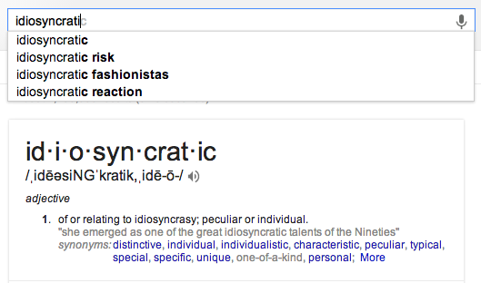
Focusing on the individual
Notes:
Idiosyncratic longevity risk
For advisers we don’t have the comfort of averages. Our clients don’t care if our other clients lived out their retirement comfortably what matters is that they lived out their retirement comfortably.
This drives a worst case scenario approach to managing money but this does not mean put all your money in cash.
Picture of actuary awake at night average life expectancy has gone up by X
Picture of adviser awake at night client X life expectancy is longer than he / she budgeted for.
By definition we need to budget as part of the planning process
But idiosyncratic risk can be changed diet lifestyle exercise so live fast die young. Encourage clients to invest in their health as well as financial assets.
Invest in their relationships – marital counselling

Slide 9

Considering options and balancing trade-offs

Slide 10
Focusing on the retirement income question
How much can I safely spend from this portfolio without needing to worry about the markets? Or What is the Safe Withdrawal Rate (“SWR”)?
Based on forecast average returns it’s 6.5%
But don’t return sequence and volatility matter?
Yes, based on historical backtest it’s 4.0% i.e. c.2.5% safety margin
What does that assume the optimal allocation to equities is?
c.60% (varying 40-70% in some studies)
Notes:
In an interesting exercise, one of my graduate students used Monte Carlo simulations for different types of asset allocations with a 99% confidence level of not running out of money to determine how much money could be spent in retirement. Fundamental client question.

Slide 11
Does the SWR analysis extend to Ireland?
Country | SWR | @4% # yrs worst case | @4% 30 yr failure rate (%)
Canada | 4.42 | 30 | 0.0%
Sweden | 4.23 | 30 | 0.0%
Denmark | 4.08 | 30 | 0.0%
United States | 4.02 | 30 | 0.0%
South Africa | 3.84 | 27 | 1.3%
United Kingdom | 3.77 | 26 | 3.8%
Australia | 3.68 | 25 | 2.5%
Switzerland | 3.59 | 26 | 5.0%
The Netherlands | 3.36 | 22 | 2.5%
Ireland | 3.28 | 21 | 25%
Norway | 3.13 | 20 | 32.5%
Spain | 2.56 | 19 | 36.3%
Italy | 1.56 | 6 | 62.5%
Belgium | 1.46 | 11 | 40.0%
France | 1.25 | 7 | 42.5%
Germany | 1.14 | 9 | 25.0%
Japan | 0.47 | 3 | 37.5%
Source: “An International Perspective on Safe Withdrawal Rates”, Wade Plau, Journal of Financial Planning, Dec 2010

Slide 12


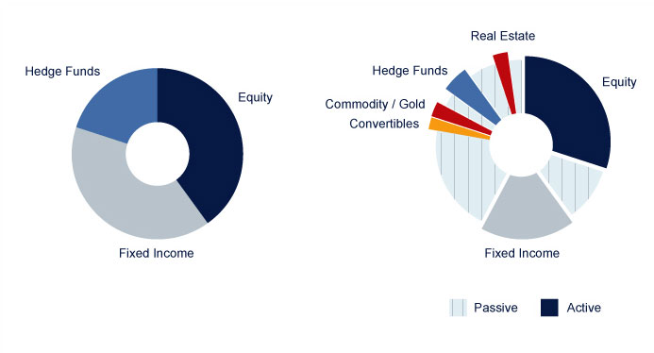
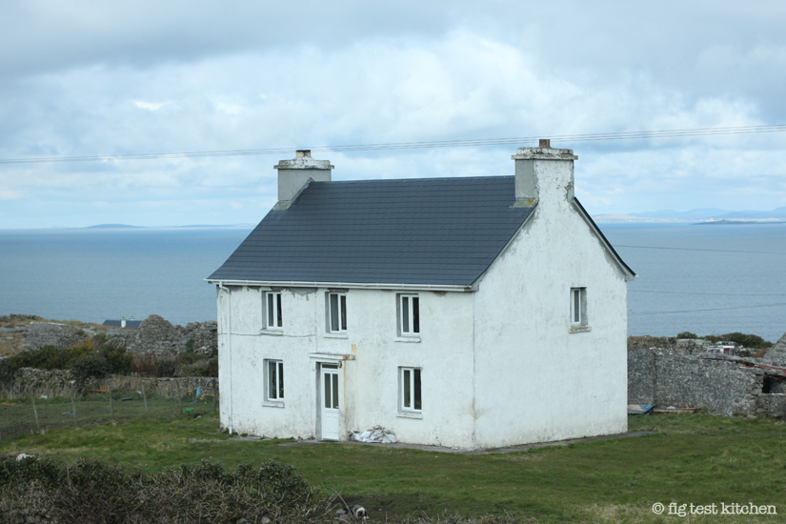
An important assumption!
X
X

Slide 13
What about….?
Base Safe Withdrawal Rate |  | 4.0%
Adjustments
Fees/Alpha | -1% to +1%
Taxes | -0.25% to -0.75%
Longevity Hedge | 0% to -0.4%
Time Horizon | -0.5% to 1%
Diversification | 0.5% to 1%
Spending flexibility | 0% to 1%
Risk Tolerance | 0% to 1%
Valuation Environment | 0% to 1%
Tactical Asset Allocation | 0.0% to 0.2%
Sum Total of Adjustments |  | [X]%
Final Safe Withdrawal Rate |  | [X]%
Source: “20 Years of Safe Withdrawal Rate Research” Michael Kitces, The Kitces Report March 2012

Slide 14
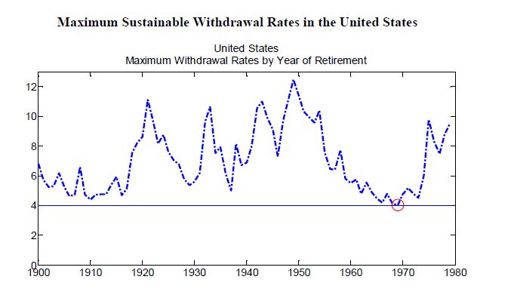
But are we asking the wrong question?
Source: “An International Perspective on Safe Withdrawal Rates”, Wade Plau, Journal of Financial Planning, Dec 2010

Slide 15
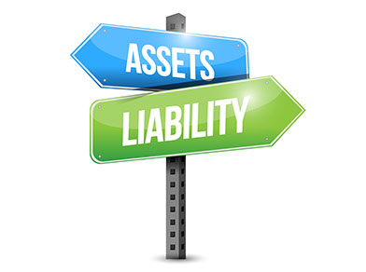
Asset Liability Management for the individual
Deferred annuity
Dynamic Equity Allocation
Long term care insurance
Larger flexible reserve
Annuity for minimum income level
Move to Dynamic Withdrawal strategy
Lower strategy volatility
Purchase a deferred annuity
Have a contingency plan (equity release, family support)
Moving to a Dynamic Withdrawal Strategy
Out | In
Fixed amount | Changing % - probability of failure
Fixed % | Changing % - 1/life expectancy
 | Changing % - combination
Notes:
Trying to fit a DB approach to a DC world or trying to fit a on-off decision to a 30yr journey. carry additional cash reserves and deplete in times of volatility.Use Transatlantic journey example. reduce equity exposure at time of retirement and rebuild through retirement. carry additional cash reserves and deplete in times of volatility. diversify portfolio across asset classes and incorporate lower volatility absolute return strategies
How do you advise someone who doesn’t have mental capacity. We are entering the realm of fiduciary. Start at 3-4% of asset base with proactive monitoring process

Slide 16
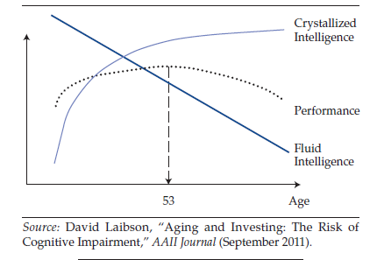
How will we be positioned to take these important decisions?
Cognitive Capacity
Source: “Aging and Investing: The Risk of Cognitive Impairment” David Laibson, AAII Journal, September 2011
Notes:
First the good news we are living longer. Then the bad news almost half that time is spent in poor health. As part of the retirement planning process, people need to acknowledge the objective evidence that as they get older, their ability to make complex financial decisions is going to decline. So, plan for that. Decisions need to be made that reduce the potential loss from that decline occurring. Multiple advisers

Slide 17

What you can’t input in the model…
Source: Irish Examiner Graphics
Notes:
How do you advise someone who doesn’t have mental capacity. We are entering the realm of fiduciary. Planning for
cognitive and physical changes in old age should be considered part of the responsibility of a fiduciary adviser. It may be that the biggest risk to a retiree’s portfolio is not a bear market but a decline in cognitive ability without a plan and without awareness that it is occurring e.g. encashing all their assets in 08/09. Let’s put some numbers on this
Annuity or DB Income requires virtually no ongoing engagement.
Managing wealth through retirement requires some level of decision making to be made.
Capacity to make and understand decisions important;
1. Does the client understand the information relevant to the decision?
2. Can the client retain the information?
3. Can the client use or weigh up the information as part of the process of making the decision?
Benefit of having a power of attorney?
Role of the advisor in the relationship
Annuity or DB Income provides easy to understand benefits to spouse in the event of death of the member – usually a percentage payment for their lives.
When building a retirement portfolio, not uncommon for one partner to have made most of the decisions.
Would the surviving spouse be capable of stepping into the financial shoes of their partner and manage the retirement portfolio?
Benefits of planning retirement together
Role of the advisor in the relationship
Estimated 40% of all people over 65 have limiting longstanding illness
In 2014 estimated dementia sufferers 850k rising to 1.14m in 2025 305 of people at age 80
CSO estimates it will double from 50k to 100k in 2030 and then triple by early 2040s to 150k

Slide 18
Key Takeaways
Idiosyncratic risk… and return!
The answer is 4% but are we asking the wrong question?
Asset Liability Management is as important for the individual as it is for the 10,000 member DB scheme.
A successful retirement is about more than just a secure income stream - a plan for retirement needs to include a plan for aging.
Notes:
Does money make people happier in retirement? Yes but why?
It tends to support a more active retirement more hobbies, more holidays more social engagement.
Focusing on the outcomes - what makes clients happy
- as well as investing in markets people will need to invest in their health and invest in their relationships– the most important question may not be what’s my SWR but who is the fiduciary you trust to step in if your mental cognisance declines.

Slide 19
Disclaimer
The views expressed in this presentation are those of the presenter(s) and not necessarily of the Society of Actuaries in Ireland

Slide 20
Dublin Office, Davy House, 49 Dawson Street, Dublin 2, Ireland. Tel: +353 1 679 7788. Fax: +353 1 614 8727.
Belfast Office, 2nd Floor, Donegall House, 7 Donegall Sq. North, Belfast BT1 5GB. Tel: +44 0 2890 310655. Fax: +44 0 2890 310656.
Cork Office, 89/90 South Mall, Cork, Ireland. Tel: +353 21 425 1420. Fax: +353 21 425 1410.
Galway Office, Dockgate, Dock Road, Galway, Ireland. Tel: +353 91 530 520. Fax: +353 91 530 710.
London Office, 13th Floor, Dashwood House, 69 Old Broad Street, London EC2M 1QS, England. Tel: +44 207 448 8880.
J&E Davy, trading as Davy, is regulated by the Central Bank of Ireland. Davy is a member of the Irish Stock Exchange, the London Stock Exchange and Euronext. In the UK, Davy is authorised by the Central Bank of Ireland and authorised and subject to limited regulation by the Financial Conduct Authority. Details about the extent of our authorisation and regulation by the Financial Conduct Authority are available from us on request.

Slide 21
Investing in Commodity Beta
12th November 2015

Slide 22
Introduction
Darragh O’Dowd;
  Senior Quantitative Analyst
  Irish Life Investment Managers (ILIM)
Focus:
  Composition of main passive Commodity Indices
  Futures Markets are used to Invest in Commodities
  The typical structure of Commodity Funds
  Historical performance versus other asset classes
  Outlook
Disclaimer:
The material, content and views in the following presentation are those of the presenter.

Slide 23
  Main Passive Commodity Indices
Commodity Index | Number of Commodities | Energy % | Agricultural % | Metals % | Capital Invested
Bloomberg Commodity Indices | 22 | 31% | 30% | 32% | c. $60bn
S&P GSCI Commodity Indices | 24 | 74% | 11% | 9% | c. $60bn
Credit Suisse Commodity Benchmark Index | 35 | 54% | 22% | 21% | NA
Rogers International Commodity Index | 37 | 40% | 30% | 22% | NA

Slide 24
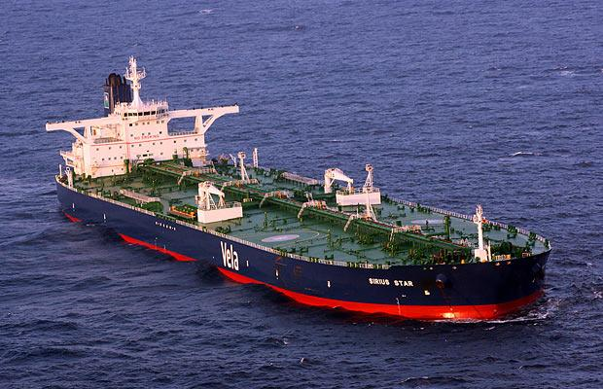
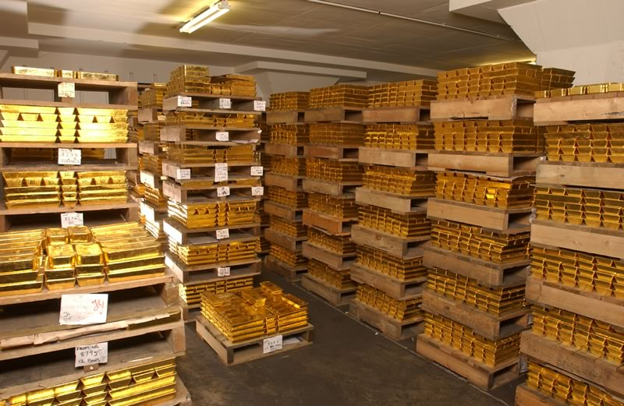
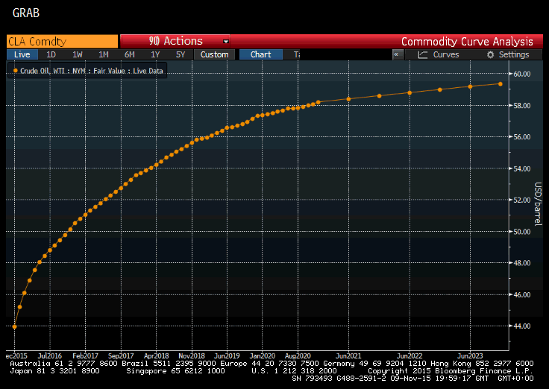
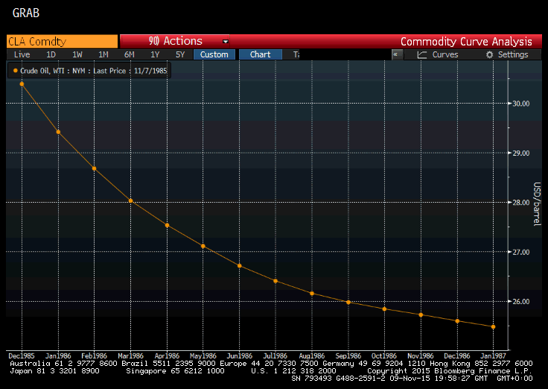
Why Futures Markets are used to Invest in Commodities
Commodity Spot Prices => Storage, Insurance, Transportation costs
Commodity Futures Prices => Roll Yield/Return
Source: Bloomberg
Source: Bloomberg

Slide 25
Determinants of the shape of the Futures Curve
r = interest rate;
u = storage costs;
y = convenience yield;
2015
1986
Source: Bloomberg

Slide 26
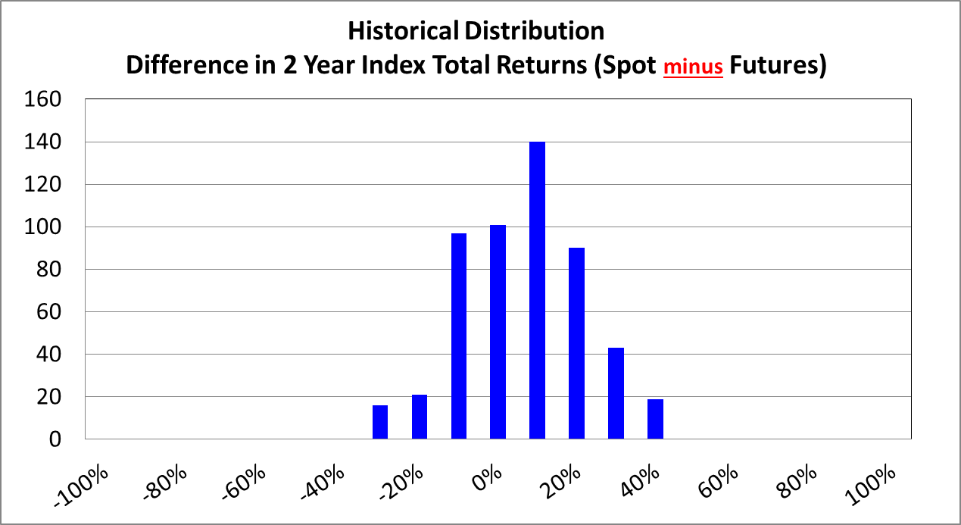
Difference in ‘Returns’ can be large
Source: Bloomberg

Slide 27
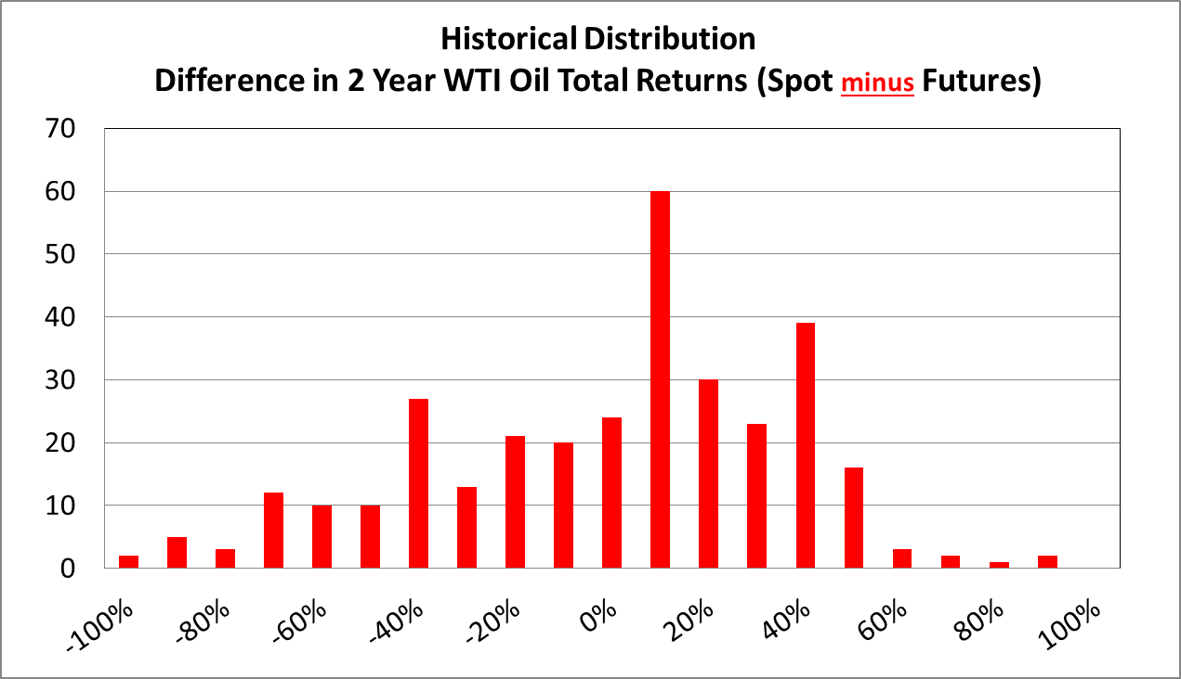
Difference in ‘Returns’ can be extreme for individual commodities
Source: Bloomberg

Slide 28
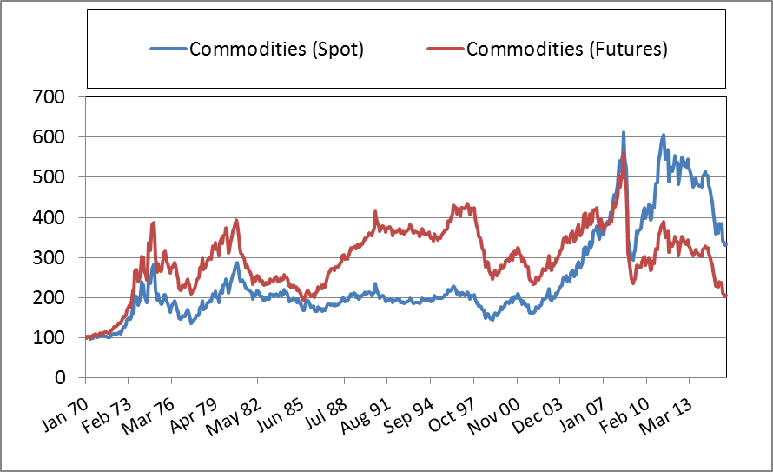
Performance Comparison through Time
Commodity Futures out-performed Spot prices prior to the late to mid 90s
Commodity Spot prices out-performed Futures prices since
Source: Bloomberg

Slide 29
  The typical structure of Commodity Funds
ETFs (UCITS Compliant)
The European Securities and Markets Authority (ESMA) guidelines for ETFs and UCITs does not allow direct investments in commodities or commodity futures
Investments in commodity futures indices that adhere to the diversification and correlation rules are allowed
  A Swap Agreement is required on the commodity futures index

Slide 30
  The typical structure of Commodity Funds
Market
2
3
Investor
Manager
4
Brokers
1
Investor purchases the ETF/UCIT from the investment manager
To create these new units, the investment manager purchases securities in the market
These securities are place in the ETF/UCIT as collateral for the swap agreement
The manager enters a swap agreement to exchange the performance of the collateral for that of the Commodity Futures Index

Slide 31
  The typical structure of Commodity Funds
Commodity
Funds
Collateral:
What?
Why?
Risks
Swap:
Who?
Fee (not in TER)?
Risks

Slide 32
  Historical performance versus other asset classes
Performance Statistics (USD): Jan-1970 to Oct-2015
 | Commodities (Spot) | Commodities (Futures) | Commodities (Futures + T-Bill Return) | Equities | Bonds
Return | 2.7% | 1.6% | 6.9% | 9.7% | 8.2%
Volatility | 16.4% | 16% | 16.1% | 14.8% | 8.4%
Maximum Drawdown | - 52.1% | - 63.7% | - 63.3% | - 53.7% | - 16.4%
Sources: Bloomberg & Factset

Slide 33
Outlook
Components of Return
Spot Return
Recent Performance
Low/Negative Returns
EURUSD Exchange Rate
Collateral Return (T-Bills)
Roll Yield
High Volatility
High Correlation
Future
Performance
Spot Return
Technological Advancement
Collateral Return
Roll Return
EURUSD Exchange Rate

Slide 34
Alternatives to the political middle ground & implications for Ireland
Professor David Farrell
University College Dublin
Talk to Society of Actuaries, November 12, 2015

Slide 35
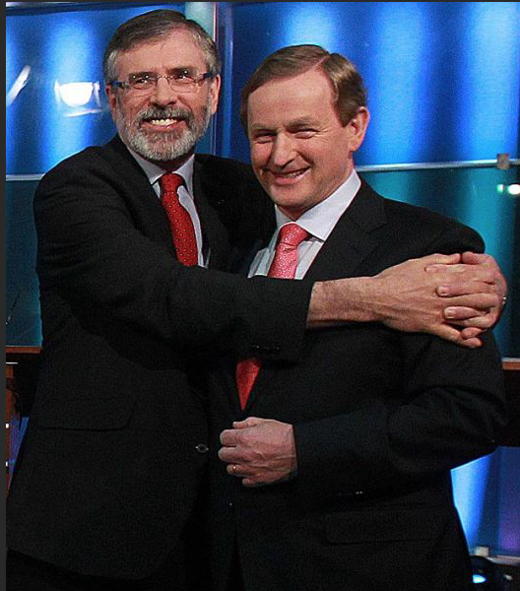
Notes:
Something we can pretty certainly rule out – i.e. a coalition that straddles the left-right divide

Slide 36
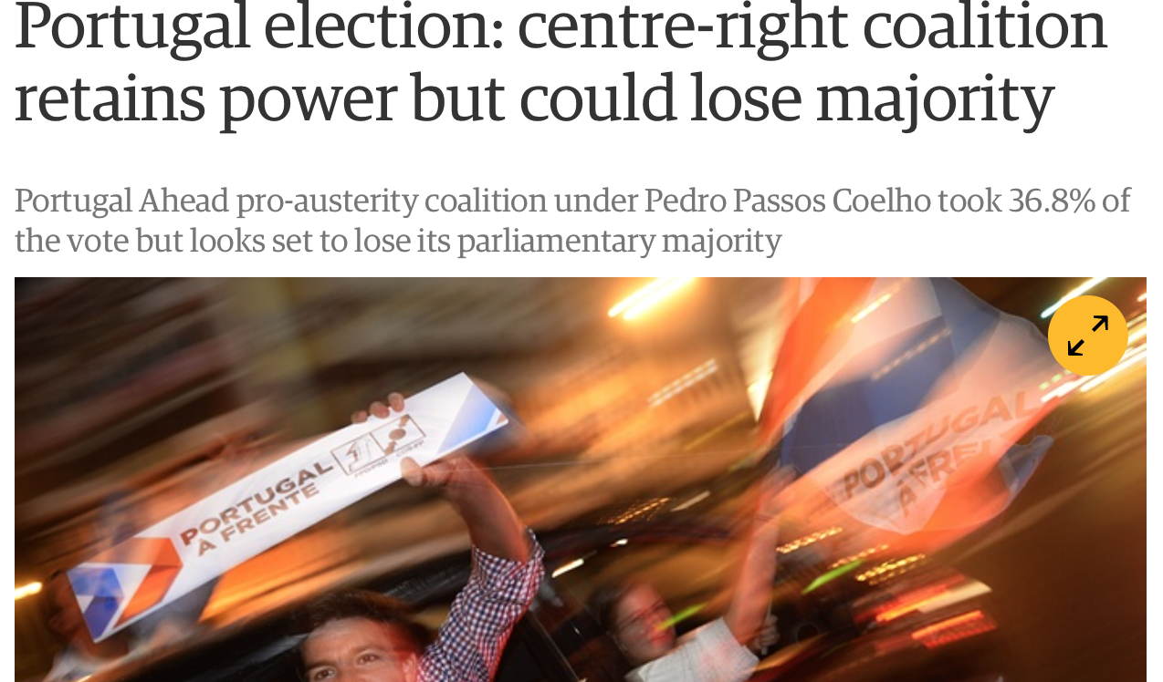
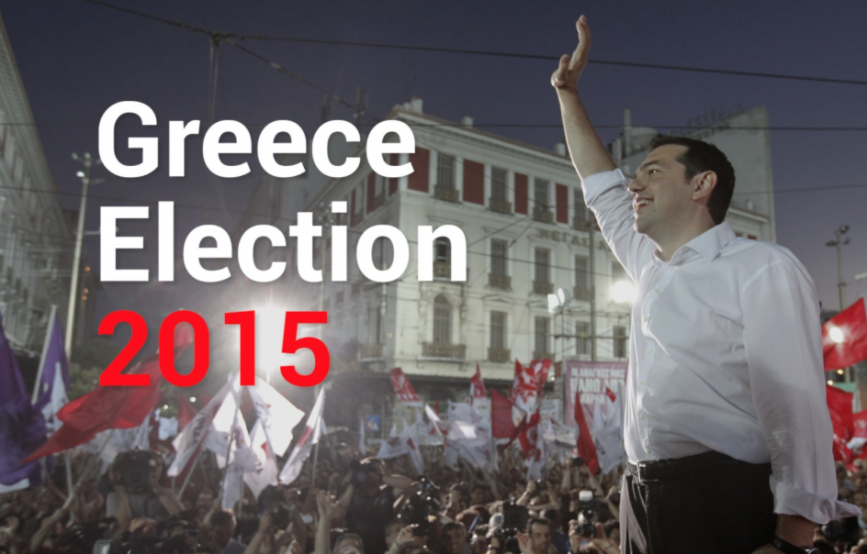
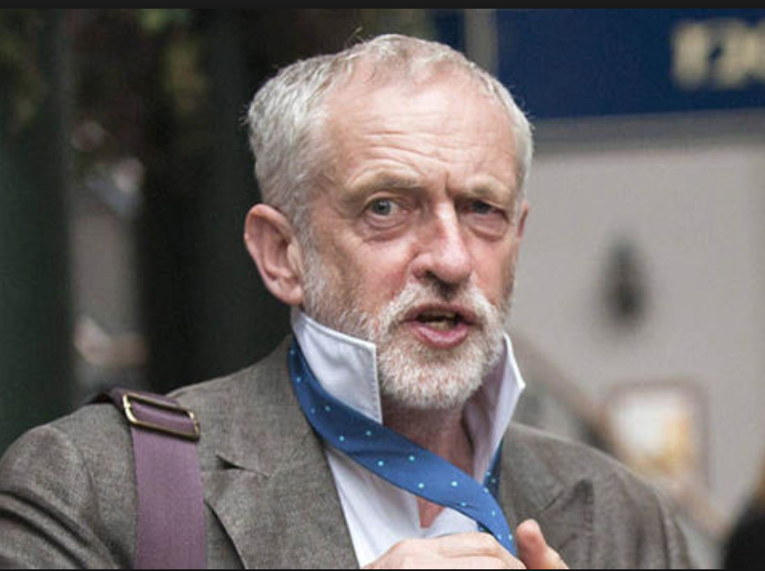
Notes:
But given what’s happened in Greece and Portugal (and like to happen in Spain) in terms of the swing to anti-austerity forced what scope for a swing to the left in Ireland in 2016?
Syriza – Alexis Tsipras
Jeremy Corbyn

Slide 37
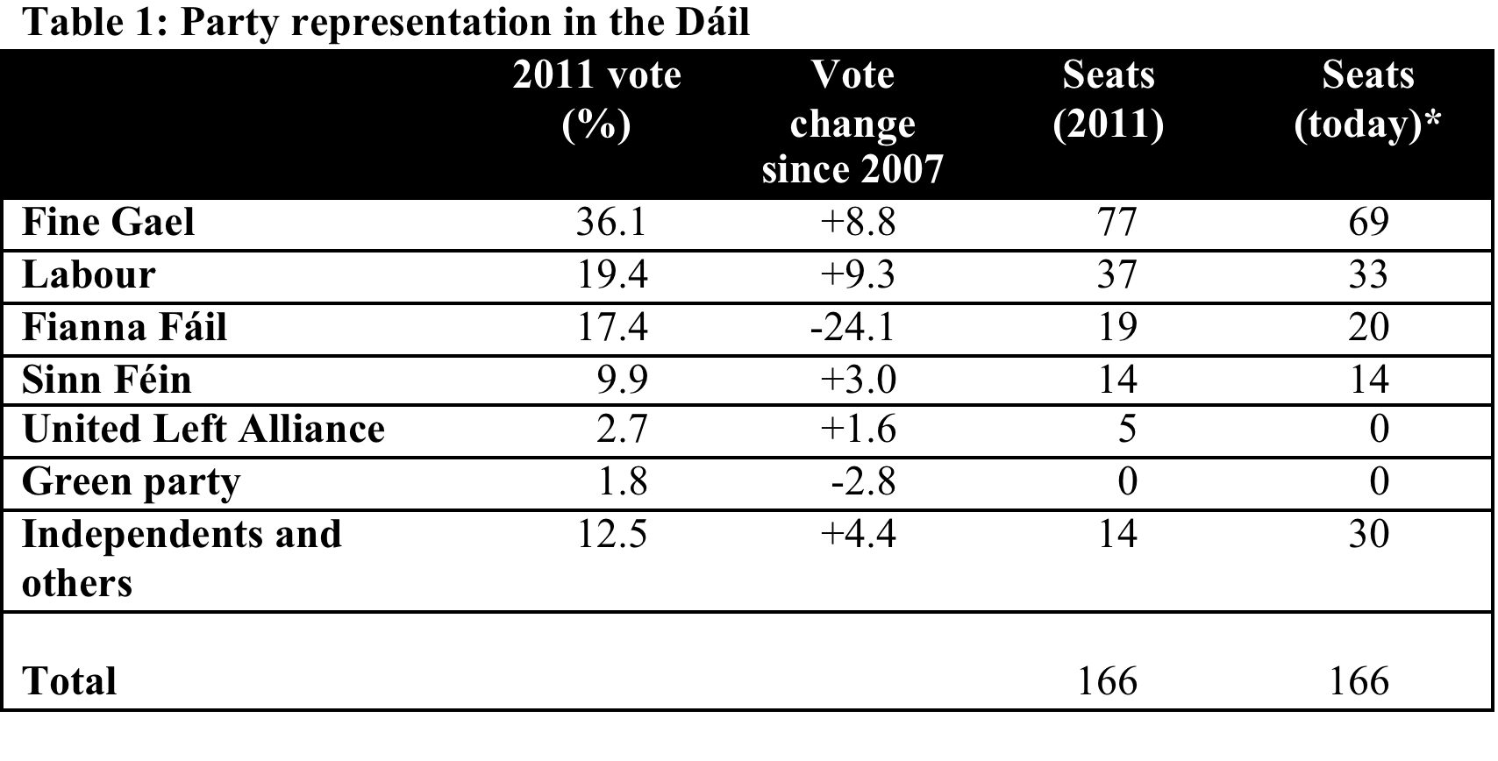
Irish politics in context
Notes:
The international Great Recession has impacted dramatically on the politics of a number of Europe’s democracies, with many observers seeing the recent Greek election result as a harbinger of things to come elsewhere. Attention is now focused on the next Irish election, which must occur no later than spring 2016, but may happen sooner.
Last election on 25 Feb 2011

Slide 38
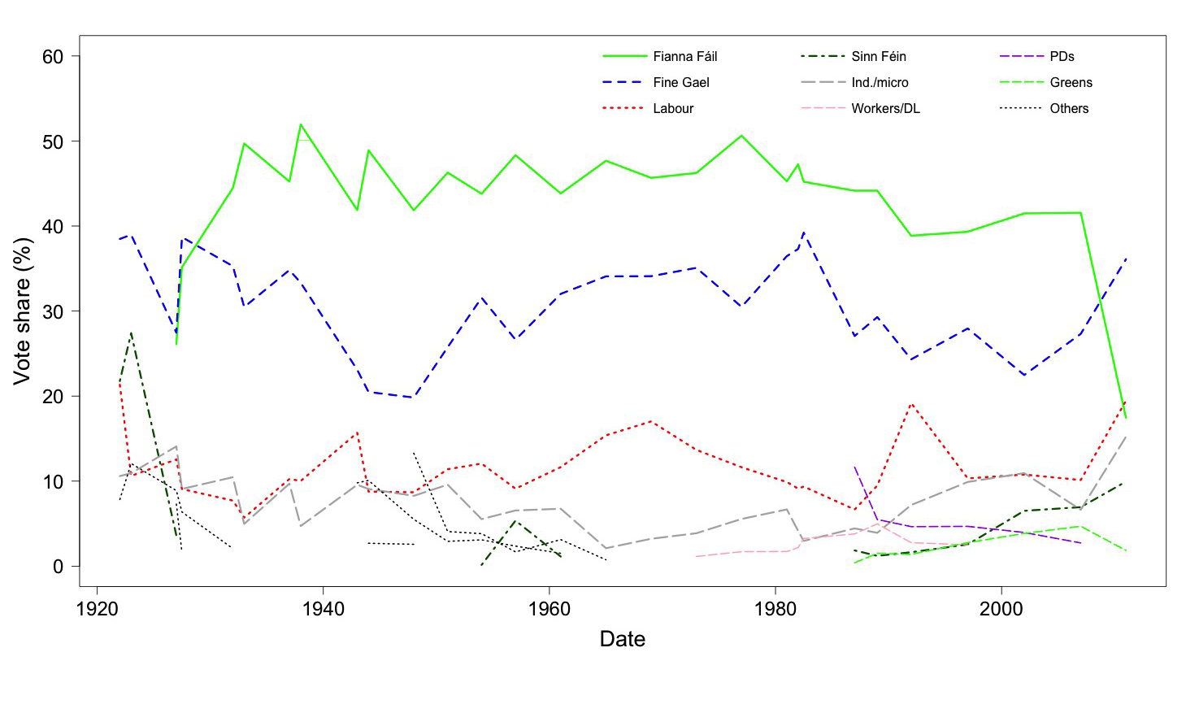
The 2011 ‘electoral earthquake’
Irish party politics, 1922-2011
Notes:
The 2011 Irish general election, held right in the heat of the country’s economic collapse, was one of the most dramatic ever witnessed: in all the established democracies only two other elections (the Italian election of 1994 and the Dutch election of 2002) have surpassed it in terms of ‘aggregate volatility’ (a commonly used measure of the extent of vote change in established democracies).
In comparative terms Fianna Fáil’s defeat was among the largest experienced by a major party in the history of parliamentary democracy. It went from being the largest party in the state (a position it had held since 1932 – see Figure 1) to being a bit player in Irish political life; it had never received so few seats (12% in the lower house, or Dáil) or such a small vote share (17.4%).
And, yet…. Much remained the same:
No new parties
FG, FF and Lab won the same share of the seats (133) that they’d won in 2002
So, already can see something about Irish politics – an inate conservatism....

Slide 39
Notes:
Could this be about to change?
Despite the pick up in the economy, the government remains unpopular. Could Irish voters be about to fling the government out of office…..?

Slide 40
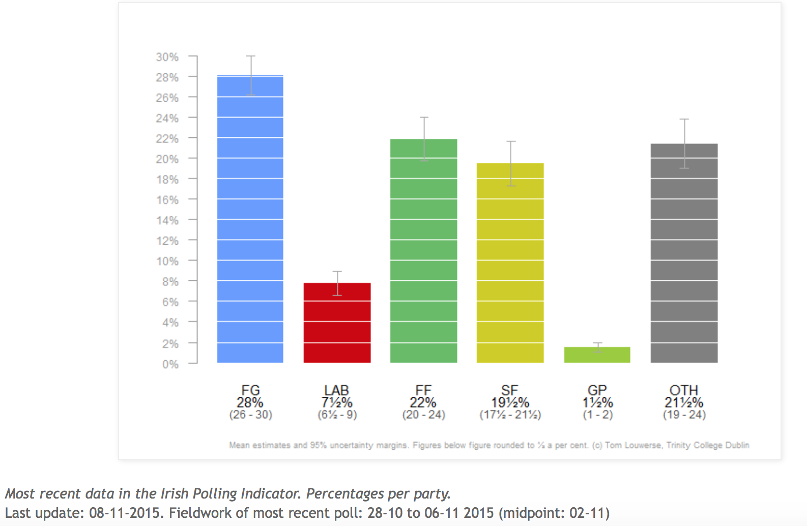
Notes:
Before we get to excited – look at the poll trends (in terms of poll of polls)
Lab definitely down
But FF looking healthier
FG certainly back to their more normal vote trends
SF double its 2011 result (9.9%)
Others v popular – but not as possible as they were a few months ago

Slide 41
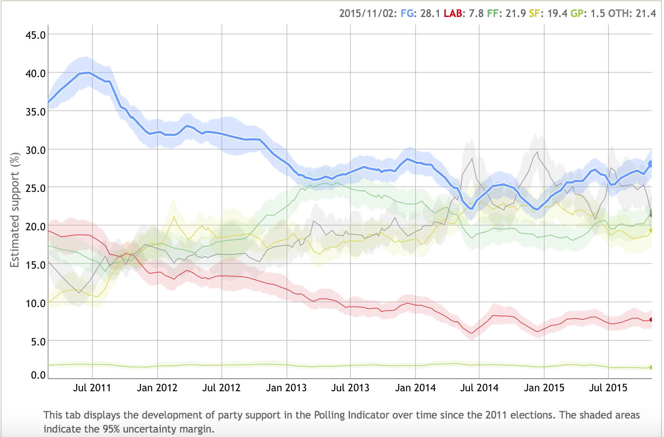
Notes:
Tracking the trends over time…..
Biggest drop for FF was in early part of the government, started to stability around 2013 and picking up in recent months
Lab: steady decline to 2014, and then pretty level since (leadership change made no difference). Not far off the magix 10% threshold
FF: biggest growth in early years of the government; pretty flat since
SF: biggest leap in first 18 months of government, and another small jump around the time of the locals; but pretty flat after that, and now trending slightly downwards
Others: pretty steady rise till about a year ago, and now pretty flat.

Slide 42
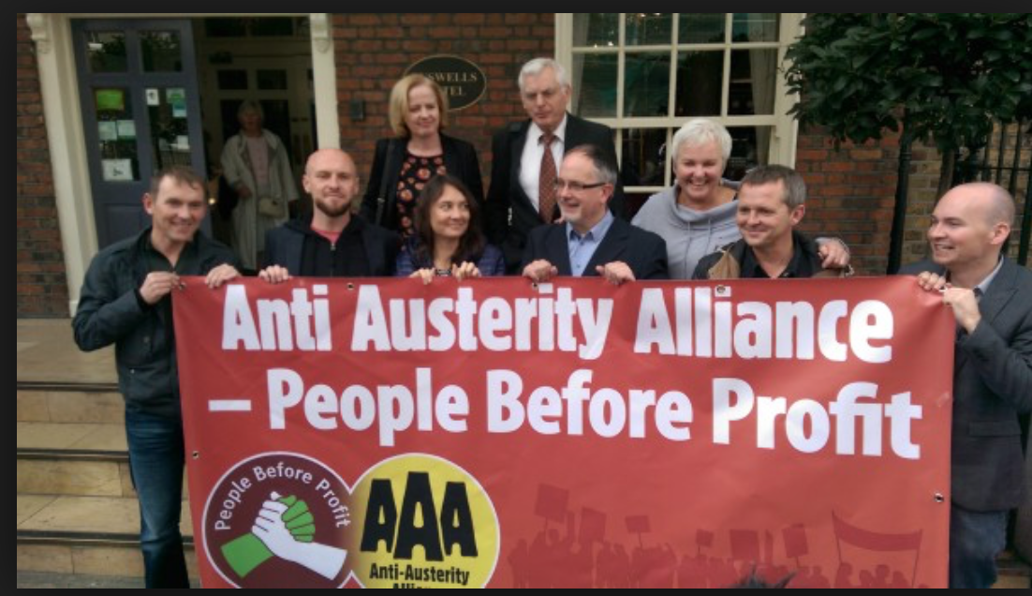
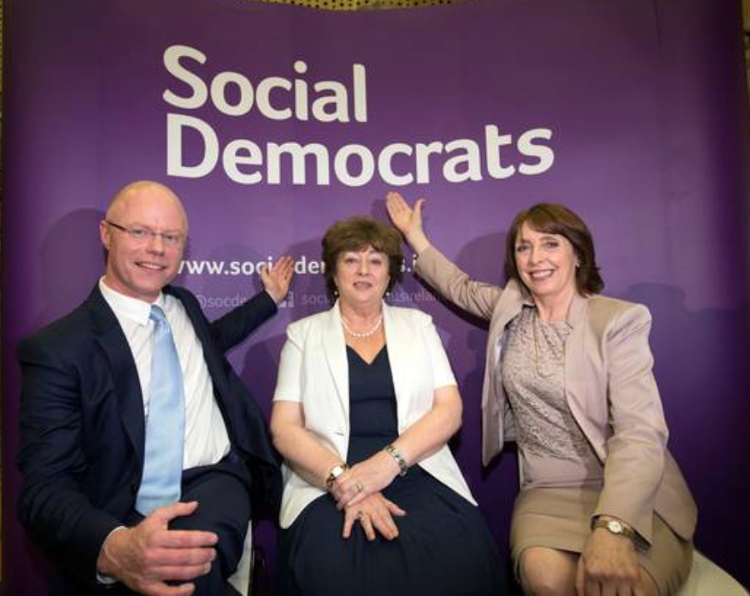
Notes:
Hard to say much about ‘Others’ because too diverse a group
Sorry history – United Left Alliance after 2011
Now AAA-PBP
The fight over whether to include SF in an elections transfers deal
Even in the case of the more moderate left SDs, can’t agree on a leader....

Slide 43
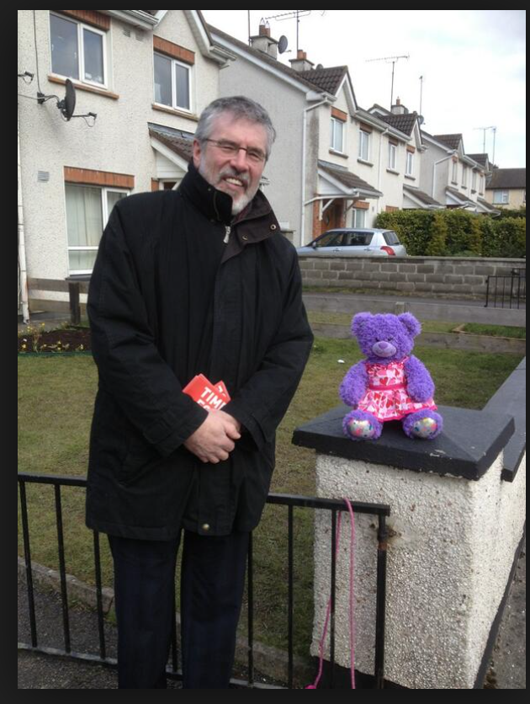
Notes:
So, that leaves us with a straightforward choice between
Some variant of current government, or
A coalition based around SF
What’s the potnetial for SF to emulate Syriza?

Slide 44
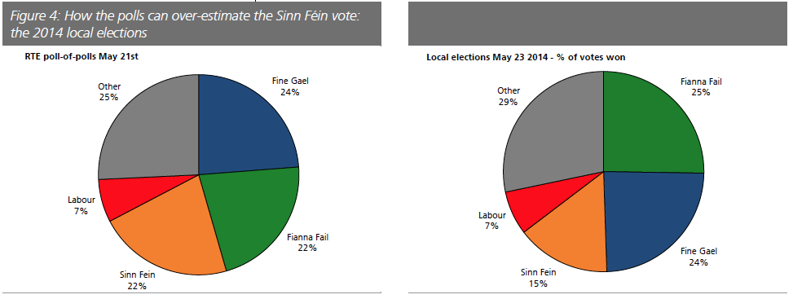
Notes:
We’ve already seen how in recent opinion polls SF appears to be flatlining.
Another feature about SF’s poll trends is that they tend to exagerate their true support
Exit polls are the most accurate polls before pollnig day; pretty good on the main parties; but not good on SF
WHY?
Where its support comes from?
The electoral system

Slide 45
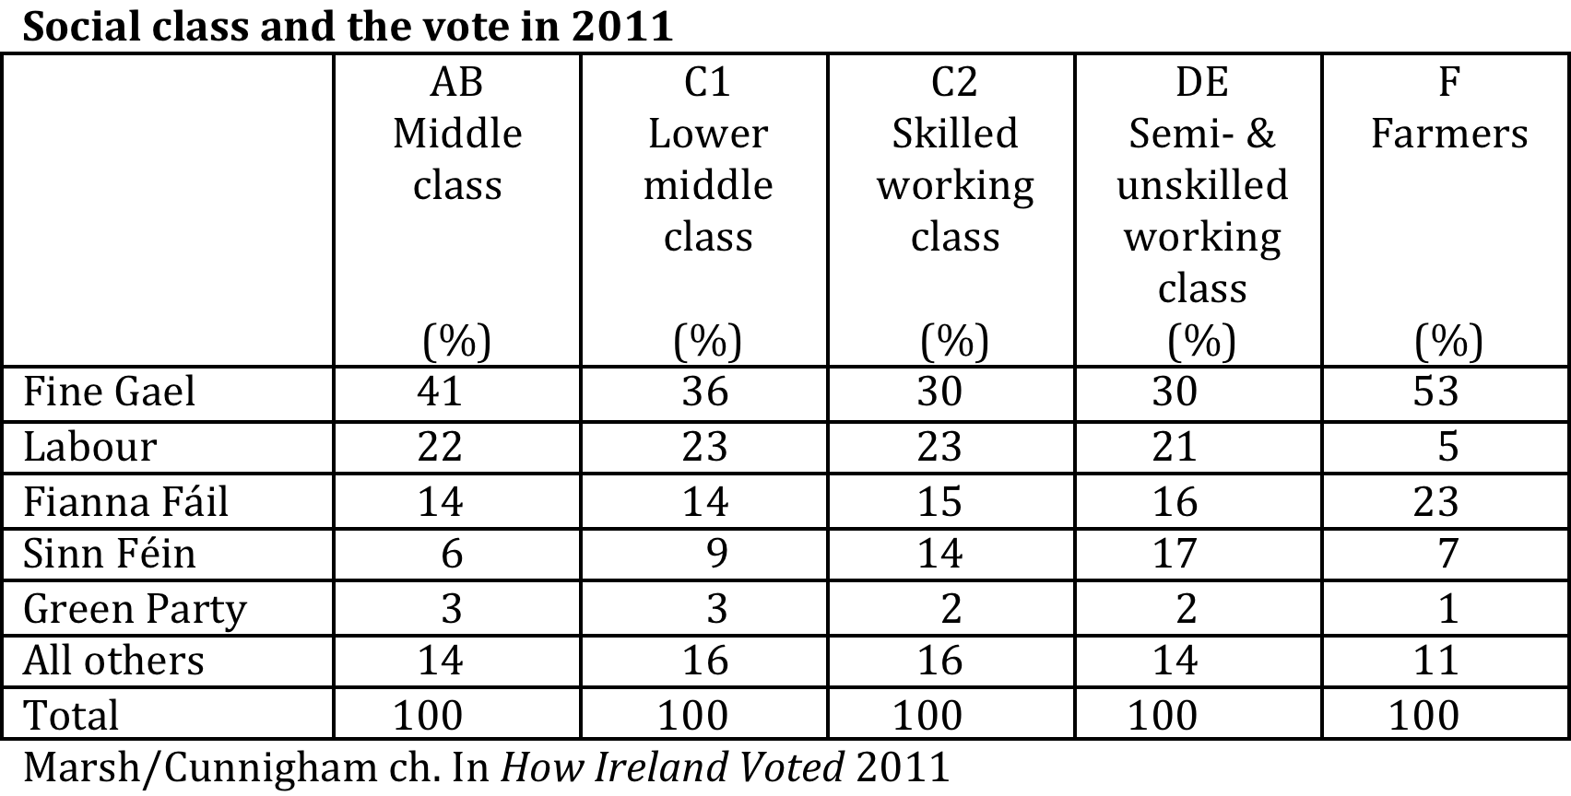
Notes:
SF’s support base is younger voters and the working classes – the areas where Syriza and Podemos also attracting votes. Indeed, in may ways the main reason why we don’t see a big breakthrough by parties like them in Ireland is because SF already occupies that territory.

Slide 46
Notes:
But the problem is that – as it well known – it is the working classes and younger voters who are less likely to vote on polling day.
So, while SF may look well in the polls, a portion of their supporters are unlikely to actually vote for them on polling day.

Slide 47
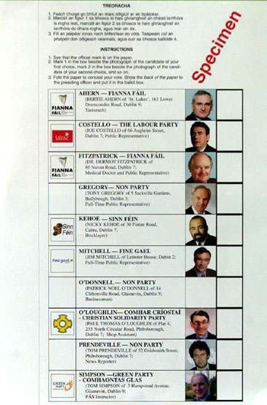
Notes:
Second, the electoral system – a unique electoral system!
A LOT hangs of vote transfers – hence recent efforts by SF to sign a pact with other parties and candidates of the left. Because it’s problem is the toxicity of the brand, so that it underperforms on transfers and that makes it more difficult to translate votes itno actual seats.
That problem is not going to go away anytime soon

Slide 48
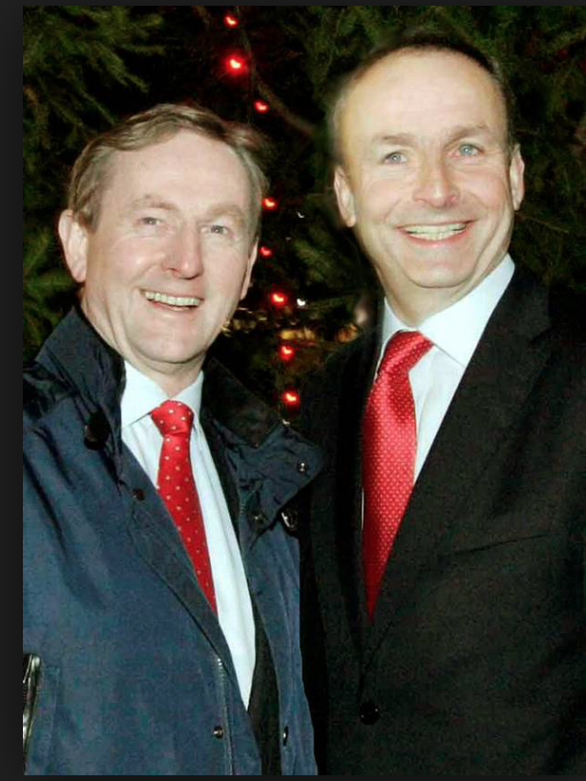
Notes:
So – where does this leave us?
Scenarios?
Version of current government
FG/FF coalition
Minority government (FG-led) with an election soon after?

Slide 49
What could an alternative left-leaning government mean?
 | SF | People Before Profit Alliance
Water/property charges | Abolish both immediately | Abolish both immediately
Personal tax | New 48% band on those >€100k New 15.75% employers’ PRSI on >€100k Retain 10% USC on >€100k; abolish USC on <€17542 Wealth tax of 1% on net assets >€1m | 4 new tax bands: €100-140k = 50%; €140-180k = 55%; €180-250k = 60%; €250+ = 65% USC changes: <€30k = 0%; €30-60k = 2.5%; €60-100k = 5%; €100k+ = 7.5% Wealth tax of 2% on >€1m
Pay | Reduce public sector pay & pensions: by 15% on €100-150; 30% on €150k+
Pensions | Reduce earnings cap for pension contribs from €115k pa to €70k
Other | Increase stamp duty on share transactions from 1% to 1.1% | Introduce a financial transaction tax od .1% on securities and .01% on derivatives Freeze all debt repayments relating to post-2008 crisis Establish a nominal corporate tax of 15% (an effective tax of 12.5%)

Slide 50
What could this mean?
Personal
  Increased personal tax/wealth tax
  More equitable society?
  Drive talent/assets overseas
  Tax evasion
Pensions
  Reduce pension reliefs
  Bring back pension levy
  Reverse extension to retirement age?

Slide 51
What could this mean?
Economy/Industry
  Higher corporate tax rates and its impact on future international business?
  Freeze debt payments? (What happened to Syriza?)
  Increased transactions taxes and its impact on Irish Funds industry

Slide 52
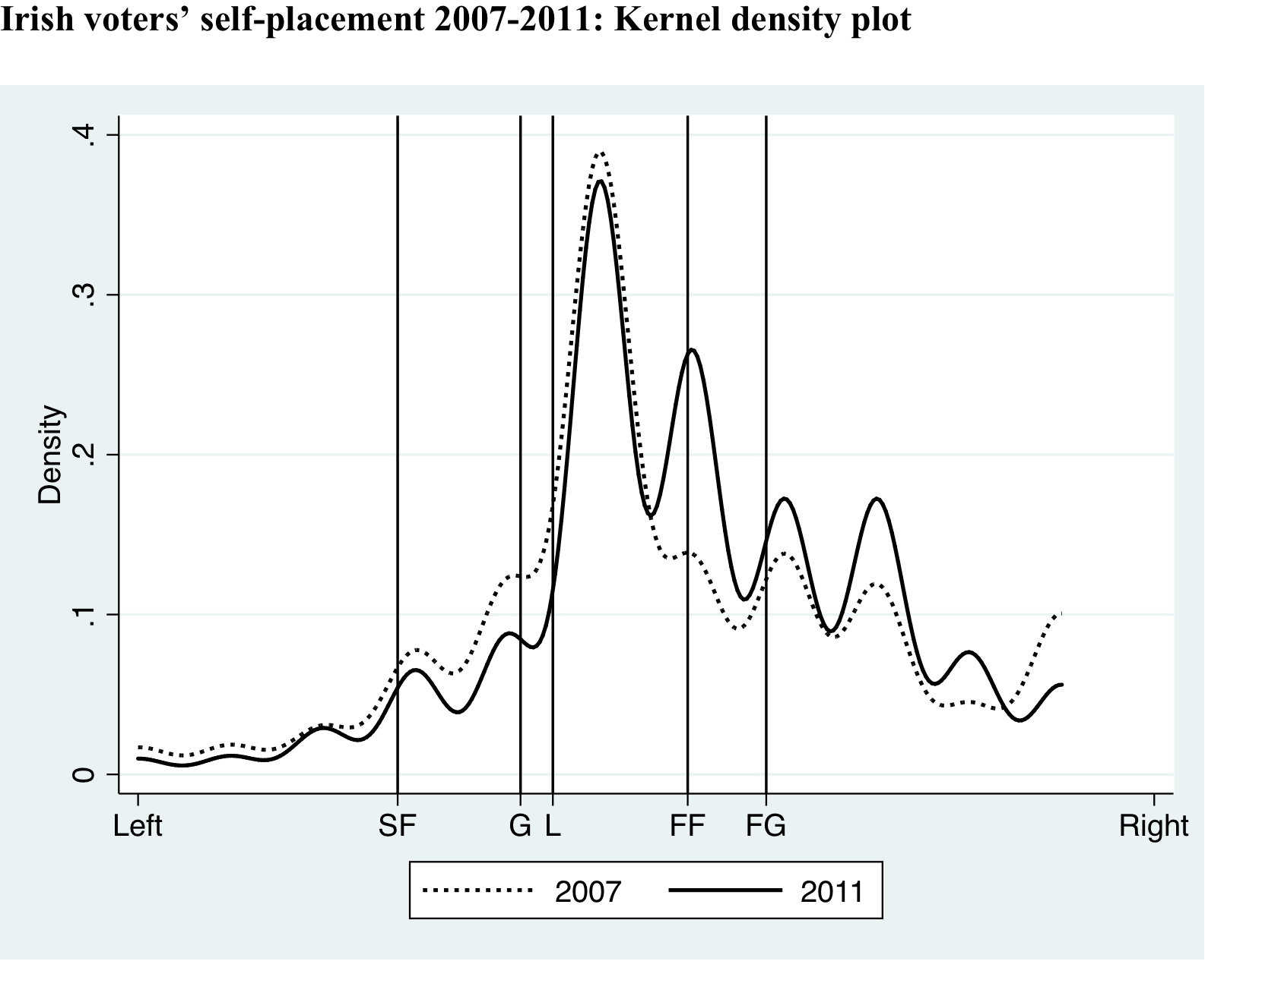
Notes:
But – bascially – this is NOT going to happen (or, at least, anytime soon)
the innate conservatism of the Irish voter (helped by emigration).
The space – such as there is – for a new party is where the PDs used to be
Could this be the moment for Renua? Poll trends suggest not.

Slide 53
Thank you!
David.Farrell@ucd.ie

