Slide 1
If Not Normal, then What?
Andrew D Smith PhD Hon FSAI
13 February 2025

Slide 2
Disclaimer
The views expressed in this presentation are those of the presenter and not necessarily those of his employer nor the Society of Actuaries in Ireland.

Slide 3
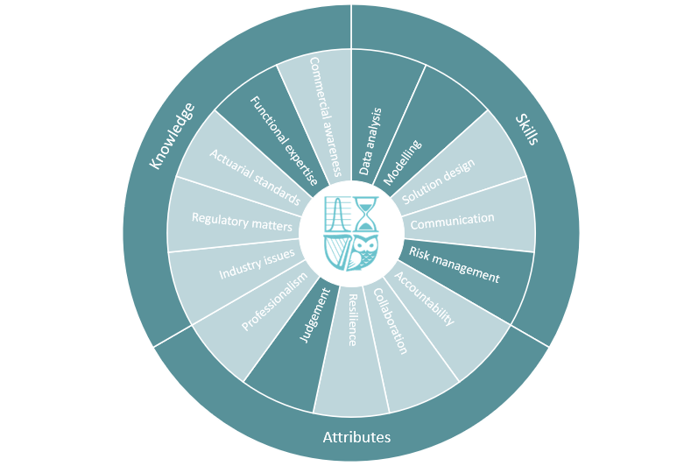
Competency Framework Wheel

Slide 4
Presentation Overview
Introduction
Extensions of the normal
16 Examples
Does our choice matter?
This changes everything
Portfolio selection
Hypothesis testing
Conclusions

Slide 5
Presentation Overview
Introduction
Extensions of the normal
16 Examples
Does our choice matter?
This changes everything
Portfolio selection
Hypothesis testing
Conclusions

Slide 6
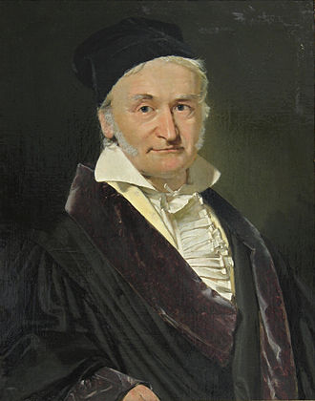
What is a Normal Distribution?
0.4
Probability Density Function
0.3
34.14%
34.14%
0.2
13.59%
13.59%
0.1
Karl F Gauss
2.14%
2.14%
0.13%
0.13%
-4
-3
-2
-1
0
1
2
3
4
Standard deviations from the mean

Slide 7
Irish Stock Market Index (ISEQ), Daily, 1997-2025
12000
10000
8000
6000
4000
2000
Data source: Yahoo Finance
0
1997
2002
2007
2012
2017
2022

Slide 8
Weekly (Log) Share Returns: QQ Plot versus Standard Normal

Slide 9
Economic Scenarios: Universality and One of my Personal Failures.
Weekly log index changes
Serial Dependence
Annual log index changes
Simple Economic Scenario Generator
Normal Distribution
Independent
Normal Distribution
Complicated Economic Scenario Generator
Normal Inverse Gauss (NIG) Distribution
Independent
NIG Distribution but very nearly normal
Mean-preserving construction
Universality: normal distributions pop up as limits (central limit theorem) even when the original specification did not mention them.

Slide 10
Normal Distributions and Economic Capital Models
Firm |  | Stated 1-year Value-at-Risk 2007 year end | Loss during 2008 (freq based on extrapolated normal)
AIG | Amount | $14.5bn - $19.5bn | $99.3bn
 | Frequency | 1-in-2000 years | 1-in-4×10⁶² years
Fortis | Amount | €17.6bn | €28bn
 | Frequency | 1-in-3333 years | 1-in-40 000 000 years

Slide 11
Presentation Overview
Introduction
Extensions of the normal
16 Examples
Does our choice matter?
This changes everything
Portfolio selection
Hypothesis testing
Conclusions

Slide 12
Normal Extension: Contamination Approach
Name | Height (cm, estimated)
Bobby Sands | 176
Fionn Mac Cumhaill | 1646
Gerry Adams | 188
Hazel Chu | 161
Leo Varadkar | 193
Mary Lou McDonald | 165
Mary McAleese | 178
Michael D Higgins | 160
Micheal Martin | 185
Michelle O'Neill | 164
Contamination approach:
Most observations are normal, but a few come from another distribution, often representing errors in data recording.
Extrapolation approach:
The same process generates moderate and extreme observations.

Slide 13
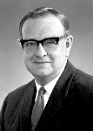
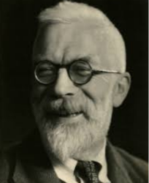
Median-Preserving Construction (Extrapolation, CF3 Distribution)
QQ Plot for a CF3 Distribution
Suppose Z is normal with mean 0 and standard deviation 1.
Then write X = Z[ 1 + (Z-1)² ]
This is an increasing function of Z, passing through (0,0), and so the median of X is the median of Z, which is 0.
Applying an increasing cubic to a normal variate produces a Cornish-Fisher 3-term (or CF3) distribution.
The CF3 distribution family is an example of a Q-linear family because an affine mix of Q-Q plots from the family is still in the family (ie a linear combination of cubics is still cubic).
20
X
10
0
-3
-2
-1
0
1
2
Z
3
-10
-20
-30
-40
Edmund Cornish
Ronald Fisher
-50

Slide 14
CF3 PDF: Left-Skewed and Fat-Tailed (Leptokurtic)
0.5
mode > median
Probability density
0.4
CF3: X = Z[1+(Z-1)²]
Standard normal Z
Tweak the four coefficients in a cubic polynomial to capture desired mean, standard deviation, skewness and kurtosis.
0.3
0.2
median zero
-2 = mean
< median
0.1
very fat tail
fat tail
0
-5
-4
-3
-2
-1
0
1
2
3
4

Slide 15
Sixteen Constructions of Four-Parameter Distribution Families
Mode-
Preserving
PIV
JF
QED
Mean-Preserving
IID sums
NCT
HYP
g-and-h
LS
EGB2
SHT
VG
NELE
CF3
JSU
NIG
NRIG
ETTN
Median-
Preserving
Q-Linear
Contains EXP

Slide 16
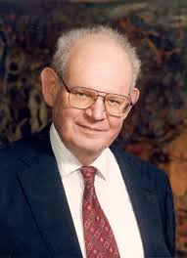
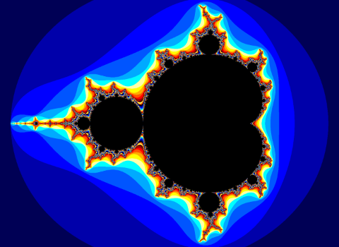
Benoit Mandelbrot said: Look for Self-Similarity in the Tails
Mandelbrot was the first to propose using Levy Stable (LS) distributions to model financial returns.

Slide 17
Mandelbrot’s Seven States of Randomness (based on limits)
Wild | ⓿ | Extreme randomness: All moments infinite.
 | ⓿ | Wild randomness: Infinite variance. Includes Lévy Stable (LS)
 | ⓿ | Pre-wild randomness. Variance finite, some higher moments infinite. Power law tails.
Slow | ⓿ | Slow randomness with finite and localised moments. -ln f(x) ~ (ln x)^{c} for c > 1
 | ⓿ | Slow randomness with finite and delocalised moments. -ln f(x) ~ x^{c} for 0 < c < 1
Mild | ⓿ | Borderline mild randomness. Exponential tails.
 | ⓿ | Proper mild randomness. Normal tails.

Slide 18
Does the Choice of Distribution Family Matter?
Does it matter if I use a normal distribution or one of the 16 four-parameter family generalisations?
Yes - normal usually produces lower stated risk
Does it matter which of the sixteen families I pick?
Tentative answer: not much, unless you pick LS or NELE
What confounds the comparison?
Special features of a data set, variation in fitting methods, numerical approximations.

Slide 19
Explaining the Patterns: Tangent Space. Now for Some Abstract Maths!
Any probability distribution has QQ-plot relative to the normal. We can regard the whole of the QQ-plot as one point in an infinite-dimensional space of QQ plots.
Any four-parameter family is a set of points in that space, but those points do not necessarily form a subspace. They form what we call a manifold.
Because the set might be curved, not flat.
Except for the CF3 and NELE families, which are Q-linear and so their QQ plots inhabit a flat set (4-dimensional subspace)
For the curved manifolds, we can ask about the (flat) tangent space, for example going through the standard normal distribution, which locally approximates the manifold.
All our 16 families except LS and NELE have the same tangent space at the normal, namely the CF3 family.
Tangent space is a Q-linear family of distributions
Curved manifold represents one family of distributions

Slide 20
Illustrative 2-Dimensional Section through Hyperspace
Each curve represents (a slice of) one distribution family.
Normal and exponential families are points (fewer parameters = lower dimension)
The Q-linear NELE and CF3 families are straight lines.
Other families are curves.
CF3 is a tangent at the normal to all families expect to LS and NELE.
This explains the outlier status of LS and NELE for analysis of nearly-normal data sets.
LS
NELE
Exponential
CF3
Normal

Slide 21
Presentation Overview
Introduction
Extensions of the normal
16 Examples
Does our choice matter?
This changes everything
Portfolio selection
Hypothesis testing
Conclusions

Slide 22
Investor Preferences with Skewed Investment Returns
Maximise expected return subject to an acceptable degree of risk ….
Portfolio | Return | Probability | Mean | Stdev | Skewness
Low risk | 1% | 50% | 3% | 2% | 0
 | 5% | 50%
Medium risk | -6% | 50% | 6% | 12% | 0
 | 18% | 50%
High risk | -15% | 50% | 9% | 24% | 0
 | 33% | 50%
Left-Skew distribution | -14% | 20% | 6% | 11% | -1.5
 | 11% | 80%
Portfolio mean
9%
Better
6%
Worse
3%
Portfolio stdev (risk)
0%
0%
5%
10%
15%
20%
25%

Slide 23
Equilibrium Arguments in Pricing Theory
Probability models
(non-normal dists etc)
Asset Demand
(match to supply)
aggregate
Portfolios
(asset selection)
optimise
Preferences
(how to choose between alternatives)
Option Pricing
(markets clear)
marginal
utility

Slide 24
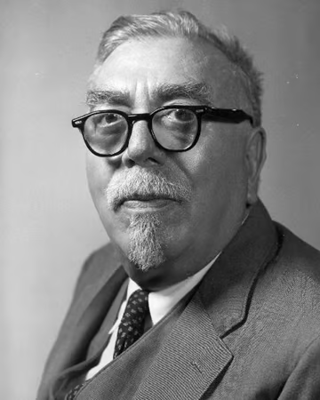
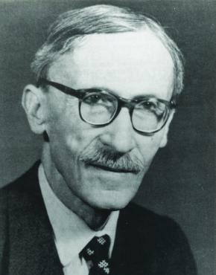
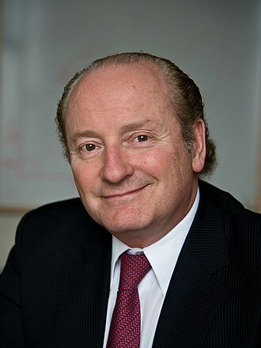
What is Special about Normal Distributions in Investment?
Norbert Wiener:
Random walks with normal increments have continuous paths.
Fisher Black
Myron
Scholes
Paul Lévy:
Random walks with non-normal increments have jumps.
Robert
Merton

Slide 25
Impact of Non-Normality on Option Pricing
The statistical fitting of fat-tailed distributions is the (relatively) easy bit.
An equilibrium model requires us to calibrate investor preferences (ugh) and not just for yourself.
If distributions are normal then the investor preference (and some aspects of the statistical estimates) cancel out. This is the Nobel-prize-winning Black-Scholes-Merton insight.
If distributions are near to normal then investor preferences do matter for pricing – but not much. Is it satisfactory (a) to estimate something we don’t know how to estimate, then (b) argue our choice did not matter much?

Slide 26
Market Momentum or Reversal (Bounce Back / Excess Volatility)
10000
Bank of England Share Price Index
(millenium of economic data)
Can actuarial schemes force transactions at smoothed prices and so reduce investment risks for all generations?
1000
1970’s oil shock
100
10
South Sea bubble
Year
1
1700
1750
1800
1850
1900
1950
2000
0.1

Slide 27
Evidence of Market Reversal relies on Normal Assumptions
Log return next year
1
Linear regression shows a slight negative slope, which indicates a rise more likely after a fall, and vice versa.
The slope appears statistically significant (just) using tests based on normal distributions.
But if two key events are treated as contaminants, we have to apply non-parametric tests and that significance ebbs away. We thought we had rejected independence, but we actually rejected a joint hypothesis of normality and independence.
1970’s oil shock
0.75
0.5
0.25
0
-1
-0.75
-0.5
-0.25
0
0.25
0.5
0.75
1
-0.25
Log return previous year
-0.5
-0.75
-1
South Sea bubble
Eugene Fama
Robert Schiller

Slide 28
Cluster Analysis and AI: Wider Implications
Identifying clusters and outliers is of importance not only for financial market data, but also customer segmentation. Normal distribution assumptions imply clusters with relatively well-defined boundaries. We may be over-stating the confidence with which we can assign an individual to a cluster.
Right now, the consequences might appear minor (eg poor targeting of online advertisements).
We should be alert to the consequences as automated decision-making grows, and in particularly the impact on minorities.

Slide 29
Presentation Overview
Introduction
Extensions of the normal
16 Examples
Does our choice matter?
This changes everything
Portfolio selection
Hypothesis testing
Conclusions

Slide 30
Conclusions
Empirical data in asset markets or elsewhere may be approximately but not exactly normal. Extrapolation to tails is heroic but not futile.
For value-at-risk calculations, implementing non-normal distributions is a plug-and-play exercise. Tail estimation is a statistical issue.
The studied alternatives to the normal distribution happen to fall in a narrow cone around the normal. Model risk may be understated if our test set is too narrow.
Option pricing theory uses normality in a fundamental way because dynamic hedging relies on the continuity of Wiener process paths. Beware false dichotomies.
Significance of observed patterns may be over-stated. For example, assuming normality, we may over-estimate our ability to distinguish clusters of customers.

Slide 31
If Not Normal, then What?
Andrew D Smith PhD Hon FSAI
13 February 2025

