Slide 1
Title here
Name(s) of Presenter & Pronouns

Slide 2
Disclaimer
The views expressed in this presentation are those of the presenter(s) and not necessarily those of their employer(s) (if any) or the Society of Actuaries in Ireland.
N.B: This slide will be included in your presentation in this order (slide 2).

Slide 3
Competency Framework Wheel
The Society developed a Competency Framework which comprises the knowledge, skills and attributes that actuaries typically draw on in their work.
Its aim is to support members in identifying their learning and development needs, in relation to both their current and future roles.
It is also used to identify which parts of the Society’s CPD programme are relevant to the development and enhancement of specific competencies.
Further information can be found here.
Please indicate which competencies your presentation covers from the list below, so we can share this with attendees to help them choose relevant sessions. The SAI Member Services Team will then generate a Competency Framework Wheel with the competencies that are covered in your presentation and include it on this slide (slide 3).
Data analysis
Modelling
Solution design
Communication
Risk management
Accountability
Collaboration
Resilience
Judgment
Professionalism
Industry issues
Regulatory matters
Actuarial standards
Functional expertise
Commercial awareness

Slide 4
Introduction and Presentation Format and Licensing
Introduction:
Use this slide to introduce yourself and give a brief introduction to the presentation i.e., tell the audience what you are going to present to them.
Presentation Format:
Slide size must be built using ‘Wide Screen (16.9)’
Ideal font size for titles is 32 and for text is 26.
SAI colours are:
RGB 0, 42, 66, RGB 88, 145, 153, RGB 0, 198, 215
You can also use any of the colours from the Standard Colour Palette on the toolbar, but please ensure that the slides are readable and avoid using colours that clash (e.g. red and green together) and your backgrounds should be neutral
Licensing:
If using any third-party materials within your presentation, the onus is on you to ensure you have the correct licensing or permission to do so. Further guidance is available on this if needed.

Slide 5
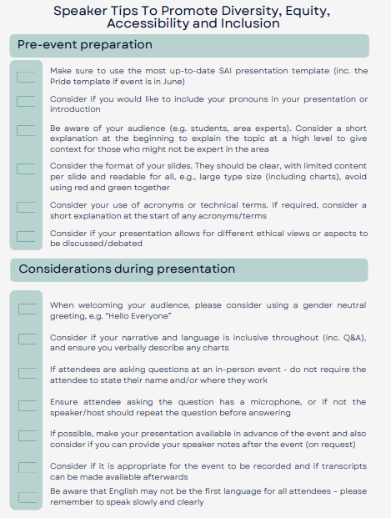
Diversity & Inclusion
Please reference the Speaker Tips To Promote Diversity, Equity, Accessibility and Inclusion document when preparing your presentation and during your presentation.
This document can be found here.

Slide 6
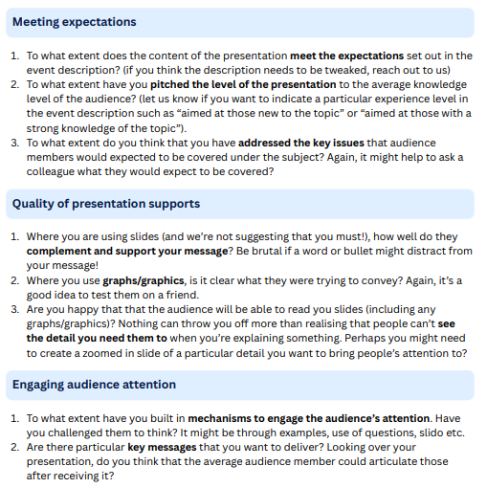
Presentation Tips
We hope you don’t mind some tips on things to bear in mind when preparing your talk. There’s a fair chance that these are second nature to you but hopefully these are of help.
We believe that good events have the following qualities:
The content meets the expectations that were set out when the event was advertised
The supports used in the event add to the understanding (and certainly don’t frustrate attendees)
Attendees are engaged during the session and are clear on the key takeaways
It might be worth asking yourself the following as you prepare your presentation (or asking a colleague for a second opinion).
This document can be found here.

Slide 7
Q&A

