Slide 1
Climate Risks and Mortality & Morbidity
Claire Booth, Milliman
23rd April 2024

Slide 2
Disclaimer
The views expressed in this presentation are those of the presenter(s) and not necessarily those of their employer(s) (if any) or the Society of Actuaries in Ireland.

Slide 3
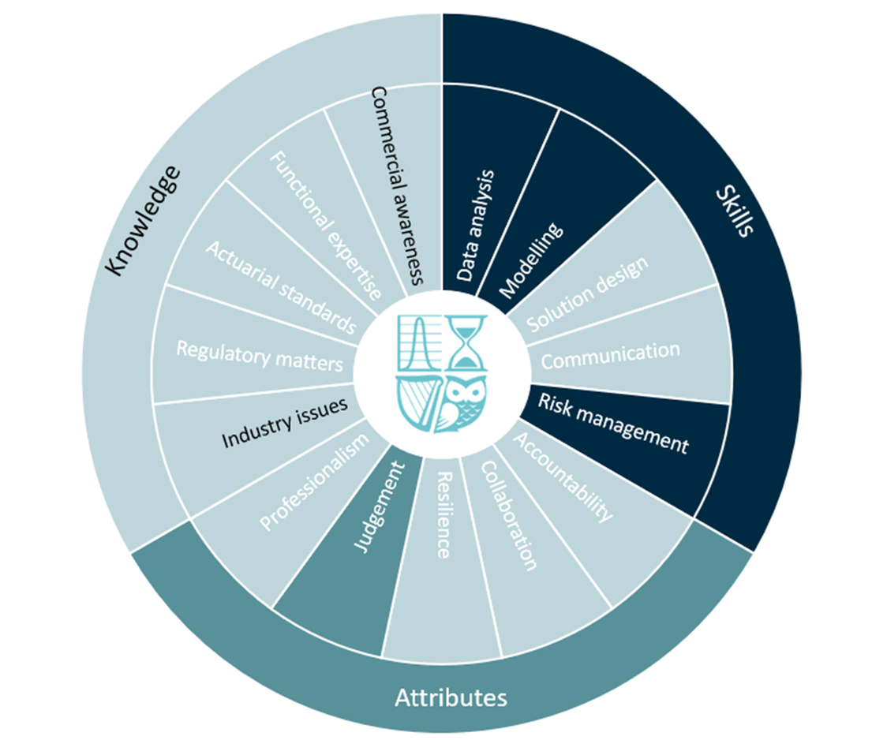
Competency Framework Wheel

Slide 4
Agenda
Aim of this session: cover some considerations for, and potential approaches to, producing climate-related mortality and morbidity stresses.
Agenda:
Why stress liability risks under climate scenarios?
Key climate risk drivers
Challenges
Market practice
Initial considerations
Potential approaches

Slide 5
The Why
Understanding of Risk Dynamics
Strategy and Product Design
Proactive Risk Management
Why is stressing mortality and morbidity important?
Climate specific dynamics
Regulation

Slide 6
Climate Risk Drivers
Extreme temperatures (Heat and Cold)
Increase in average temperatures
Disease
Air quality
Extreme weather events
Macro-economic

Slide 7
Key Challenges
Model choice: linking climate data to health outcomes
Multiple climate drivers
Availability of data
Non-linear relationships
Heterogeneity:
Population
Adaptive measures
Geography

Slide 8
UK Market Practices
Company / Report | Commentary
The Phoenix Group: Climate Report 2023 | “At this stage the evidence for the potential impact of these factors on the UK population (the Group’s major market) is inconclusive, so we have chosen not to quantitatively model the risk of changes in mortality/longevity/morbidity as part of the climate change scenarios considered.”
Prudential Plc: 2023 Sustainability report | “We have analysed the distribution of our customers across locations to assess their vulnerability to extreme climate events. These assessments aim to improve our understanding of our customers’, and our, exposure to climate risks.
Legal & General Group Plc: 2021 Climate report | “We have built a pragmatic model capturing the key interaction between temperature and mortality rates for the UK and the US. Our modelling has focused on this link as it is an area with plentiful data and significant academic Study.”
Aviva: Climate-related Financial Disclosure 2022 | “The Climate VaR for life insurance risks calculates the impact on reserves of a change in mortality rates as a result of the occurrence of different acute and chronic physical effects in each scenario based on a review of academic literature linking climate change to potential changes in mortality rates.”

Slide 9
Initial Considerations
What are your objectives?
Decide upon key climate drivers to assess
Decide upon relevant climate scenarios to test
Availability and cost of data:
Characteristics of the inforce
External data and empirical studies linking mortality and morbidity to the relevant climate drivers

Slide 10
Approach 1: Simple Approach
1
Describe the link between climate and mortality and morbidity.
Identify the main climatic cause of deaths or increased morbidity for relevant geography.
2
Identify data sources or empirical studies that attempt to quantify the excess deaths or sickness due to the material climate driver.
E.g. data that observes excess mortality / morbidity of x% at various ages when temperatures are above y%.
3
Split the inforce block into age bands
e.g. 5 or 10 year age brackets based on policyholder groups that who are / aren’t materially impacted by the climate driver, according to the data obtained in step 2.
4
Further split the inforce block by major territory or into policyholder with / without pre-existing medical conditions.
If data permits
5
Apply the mortality and morbidity stresses, as obtained in point 2, to the groups of policyholders at ages and within geographies that are currently impacted by the climate driver.
6
Identify the future climate trajectory according to the chosen scenarios, and then make some simple assumptions around how this might impact mortality and morbidity rates in the future.

Slide 11
Approach 2: data driven approach
A climate-adapted Lee-Carter model
Milliman White Paper:
“Modeling the impact of climate risks on mortality”
1
Identify the main climatic risks e.g. the risk of heat waves, cold waves, pollution etc.
Can be identified through the study of mortality series by cause of death data.
E.g. Global Health Data (GHD) published by the Institute for Health Metrics and Evaluation (IHME).
2
Identify the appropriate data and type of modelling
For heat waves/air pollution, climate variables are available that can be correlated with climate mortality or morbidity.
3
Apply a Lee-Carter model adapted to capture the impact of a specific cause on overall mortality rates
The paper considers exposure to high temperatures in France and the US.
The paper finds that the climatic variables within the models explain the observed peaks in deaths due to summer heat waves.
4
Derive an age-specific climate impact
Apply to the age structure of the portfolio.
Source: “Modeling the impact of climate risks on mortality” by A Boumezoued, A Elfassihi, V Germain, E Titon.

Slide 12
Approach 3: Causal modelling
Causal modelling is a model that can quantitatively assess the complex system by modelling causal factors and how they interact.
Benefits include:
Reflect interconnected nature of the risks; climate risks are characterised by non-linear dynamics, multi-factor relationships, and the onset of sudden tipping points.
Ability to model multiple climate drivers.
Constant evolution of risks; update model to reflect.
Ongoing learning: understanding of the most important climate risk drivers and of the risk interactions which may drive particular outcomes and pathways.

Slide 13
Benefits and Limitations
Approach | Benefits | Limitations
Simple approach | Simple approach; good starting point. Doesn’t require large volumes of data. | Does not jointly model the impact of several climatic causes. May require an assumption of linearity
Climate-adapted Lee-Carter model | 1. Statistical data driven approach | Requires statistically significant volumes of data to apply the methodology. Derived from past data
Causal model | Develops an understanding of the complex system Model multiple climate drivers | 1. Require data on the relationships between variables in order to calibrate.

Slide 14
Climate change and life and health insurance
Gao Xiao, SCOR
23rd April 2024

Slide 15
Disclaimer
The views expressed in this presentation are those of the presenter(s) and not necessarily those of their employer(s) (if any) or the Society of Actuaries in Ireland.

Slide 16
Competency Framework Wheel

Slide 17
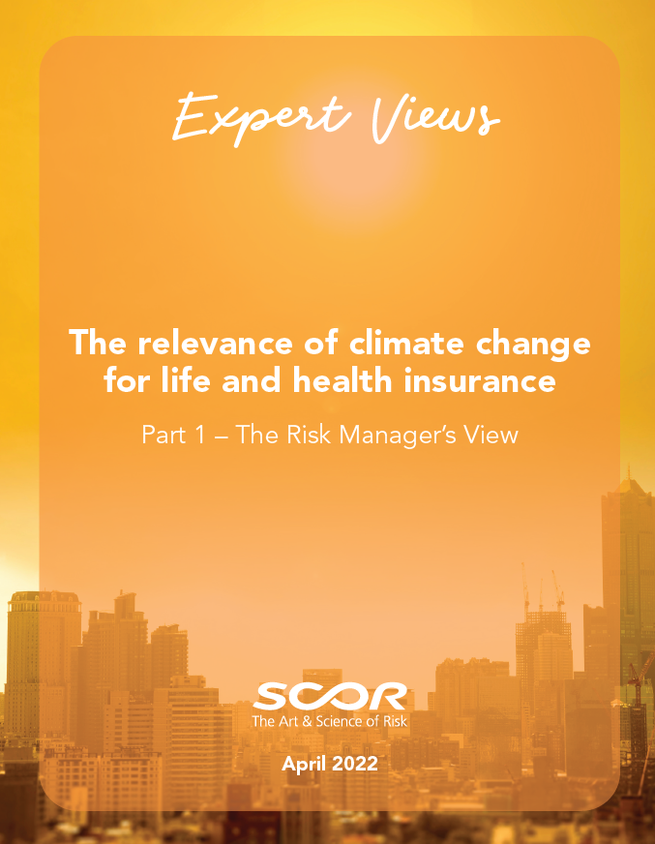
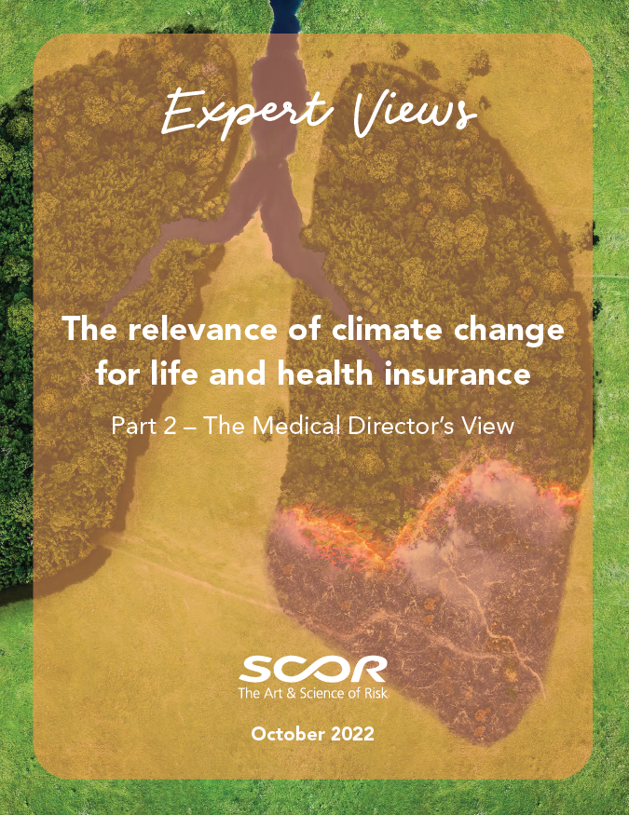
Expert views on climate change and life and health insurance
The manager’s
view
The medical
director’s view
The epidemiologist’s
view
The relevance of climate change for life and health insurers | SCOR
17

Slide 18
Climate change and infectious diseases
The pathways of interaction between climate change and infectious diseases
The relevance for Life and Health insurance
Intervention avenues

Slide 19
The pathways of interaction between climate change and infectious diseases

Slide 20
Infectious diseases
Infectious diseases are caused by pathogens: viruses, bacteria, fungi, and parasites
Infectious diseases can affect human, animals and plants.
Infectious diseases can be transmitted via bodily fluids, air, water, or food.
Vector-borne diseases are transmitted through an intermediate host like mosquito or tick.

Slide 21
Changes in spatiotemporal distribution
Warmer world with shorter and milder winters
More vectors and pathogens to survive at higher latitudes and altitudes
This increases the geographic distribution of infections, the duration of the transmission season as well as its intensity

Slide 22
Changes in spatiotemporal distribution
Warmer is not always better
Malaria transmission increases with temperature, peaks at a specific temperature, and then decreases
Some regions would become less favorable for certain diseases: plague, human sleeping sickness
Shorter epidemics of seasonal flu and respiratory syncytial virus
Climate change is not the only driver of mosquito distribution
Urbanization, changes in land use and human mobility play important roles
Mosquito’s physiological plasticity: survive in various temperate, laying winter-resistant eggs and a wide range of breeding habitats

Slide 23
Changes in pathogen and vector lifecycle
Under higher (but not too high) temperature:
Mosquitos can reach maturation faster, leading to more generations.
Malaria-causing Plasmodium parasite has shorter incubation period.
Mosquitoes' resistance to insecticides increases

Slide 24
Changes in pathogen and vector lifecycle
Climate change impacts some common infectious diseases: Escherichia coli, Streptococcus pneumoniae, Salmonella
Warmer environment increases bacterial growth rates
Increases antibiotic resistance through horizontal gene transfer

Slide 25
Changes in human-animal interactions
Environmental changes are causing increased physical proximity of pathogens, vectors, and humans.
Droughts could intensify animal interactions.
Floods and storms lead to foodborne diseases.
Reduced food availability could increase human contacts with wildlife and risk of zoonoses
Thawing of permafrost in the Artic region could expose frozen pathogens.

Slide 26
Changes in human vulnerability
biomedical
demographic
geographic
socioeconomic
sociopolitical
Climate change impacts human habitats: buildings, protective gear, access to health care, education, food quality and availability, and workplace conditions
Leads to population displacements: over-crowding, unsafe water and food favors disease transmission
Climate migrants could be exposed to new diseases

Slide 27
The relevance for Life and Health insurance

Slide 28
The relevance for Life and Health insurance
Distinguish between morbidity risk and mortality risk.
High fatality is due to limited access to healthcare among the vulnerable population
95% of malaria cases and 96% of malaria deaths in 2021 were in the African Region
Mitigation measures and effective treatment could significantly reduce disease severity and mortality risk
WHO report estimates excess deaths from malaria and dengue close to zero in high-income countries between 2030 and 2050 .

Slide 29
The relevance for Life and Health insurance
Mosquito-borne tropical diseases are expected to become endemic in Europe and North America.
Morbidity could be significant due to their high treatment costs and durations.
Severe cases suffer from long-term neurologic deficits and organ damages.
Insurance products on medical expenses, disability and long-term care are more likely to be impacted.
USD 27,642
mean cost per hospitalized malaria patient in the US

Slide 30
Intervention avenues

Slide 31
Intervention avenues
Reduce vulnerabilities: targeting comorbidities like obesity and smoking
Reduce exposure: health education campaigns on prevention and parasite control
Combat deprivation and improve access to health services
Durable and global solution: One Health

Slide 32
Intervention avenues
Healthcare system
drugs, equipment, procedures
health professionals
Government
disease surveillance systems
Insurance companies
Individuals
fast responses to health emergencies
offer suitable and affordable products
adopt preventive measures
avoid infecting others

