Slide 1
Machine Learning for Motor Pricing
25.09.2019
Date
© Society of Actuaries

Slide 2
Machine learning for motor pricing
And lessons learned in Scandinavia related to electric cars
Jan-Magnus Moberg (PwC Norway), Bence Zaupper (PwC Ireland)
Presentation for the members of the Society of Actuaries in Ireland
Dublin, 25 September 2019

Slide 3
Disclaimer
The views expressed in this presentation are those of the presenter(s) and not necessarily of the Society of Actuaries in Ireland

Slide 4
Competition law awareness
We want to remind everyone to be mindful when you are participating in any discussion.
Anti-Competition
This presentation is a knowledge sharing session and:
We do not expect any of the topics covered to be considered as anti-competitive by their nature;
Our speakers are aware of competition law;
Due to the sensitive nature of pricing and rate making in the market we ask you to also be mindful when you are participating in any discussions throughout this presentation.
Specifically, there is no exchange of commercially sensitive information including future pricing or strategic information.
We would however still strongly encourage the audience to ask questions and to join any discussions that will take place in an acceptable manner.
Thank you very much in advance for your cooperation in this very important matter.

Slide 5
About who we are and what we do
Global responsibility in PwC for Data & Analytics for insurance
Successfully helped automating the pricing process for a large Nordic non-life insurer
DATA • ANALYTICS • INSURANCE • PRICING
Utilising PwC’s customer insights platform to accelerate the development
Now offering pilots and larger projects to insurers wanting to modernise their pricing process
Jan-Magnus Moberg
Director PwC Norway
Adj Professor NHH
Leader global non-life pricing initiative at PwC
Bence Zaupper
Senior Manager PwC Ireland
Actuarial Services Analytics Lead

Slide 6
Pricing and underwriting are at the core of insurance and key components when insurers enter into a technological transformation
There are many opportunities that insurers should start exploring
“
Exploit existing data in a more effective way
83 % of Insurance CEOs state a concern about the pace of technological change
Source: Insurance CEOs participating in PwC’s 20th Annual CEO Survey
Integrate new sources of data (Big Data and third-party data) into pricing model to optimise the price and to prevent and detect fraudulent claims
Explore the benefits of data-driven-decision-making
Take advantage of a good governance structure - being data driven is complex

Slide 7
Insurer issue
Pricing models used to calculate the insurance premium are infrequently updated because of manual processes and take a long time to get to market. As a result, pricing models are often not performing as well as they should. In addition, many carriers’ legacy systems make it difficult to use new and innovative technology and models.
Our solution
We are building a pricing solution for non-life insurers where we make use of our global industry knowledge and experience. Using a Customer Insights Platform to accelerate the development, we run pilots for non-life carriers, helping them automate, streamline and modernise their pricing process.

Slide 8
Electric cars - increasing popularity across the globe

Slide 9
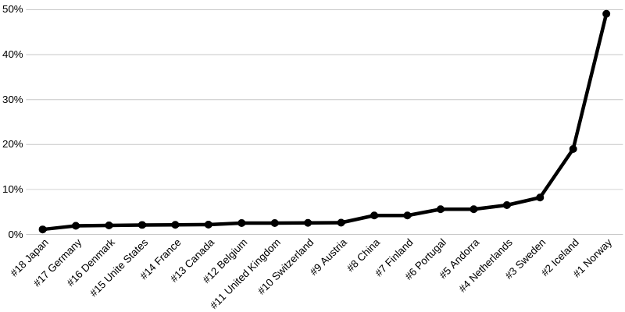
Market share of fully electric vehicles (EVs) in new sales - 2019*
(top 18 countries)
*Source: https://avtowow.com/countries-by-electric-car-use

Slide 10
Electric cars - Norway

Slide 11
International cooperation*
Nordic Energy Research (NER) is based in Oslo, co-organiser of the Nordic EV Summit, since 2016 to gather members of the automobile industry, Nordic ministers, representatives from the Nordic EV industry, researchers and others to discuss electric mobility.
Norway is member of the Electric Vehicles Initiative (EVI) a multi-government policy forum established in 2009 aiming to accelerate the deployment of EVs worldwide, and also the EV30@30 campaign launched in 2017 setting a collective aspirational goal of a 30% market share for electric vehicles (10% achieved in 2018).
*Source: International Energy Agency (IEA): https://webstore.iea.org/download/direct/1010?fileName=NordicEVOutlook2018.pdf

Slide 12
Share of fully electric vehicles being sold in Norway 2018:
48%
*By March 31, 2019 (Source: Motorvognregisteret and OFV)

Slide 13
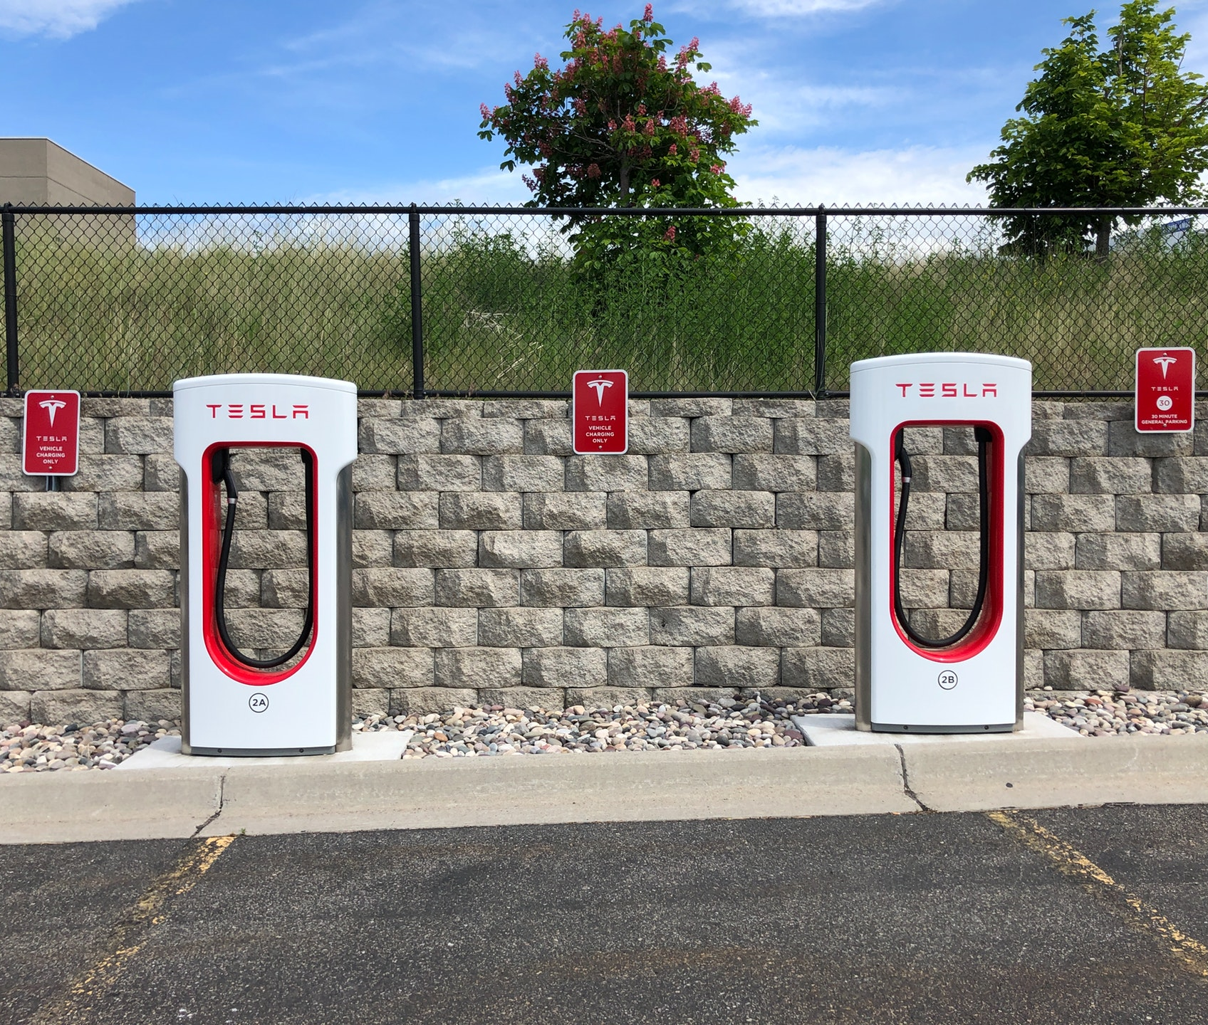
Reasons for the high number of Electric Vehicles (EVs) in Norway
Key observations
1
Financial incentives
(no sales tax, free toll passings etc.)
Insurers and banks have adapted to the large number electric cars being sold by providing own coverages and loans with better terms than fossil-fueled cars
The EV sale have exploded in a couple of years:
2011: 1%
2013: 6%
2015: 16%
2017: 20%
2019: 48%
One insurer observes that EVs are involved in 20% more accidents and that the cost of repair is 50% higher
2
Share of electric cars being sold
Relatively cheap and clean electrical power
(calculations suggests that fossil-fueled cars are more than 30% more expensive to own)
3
Investments in charging infrastructure
PwC Digital Services
Confidential information for the sole benefit and use of PwC’s client.

Slide 14
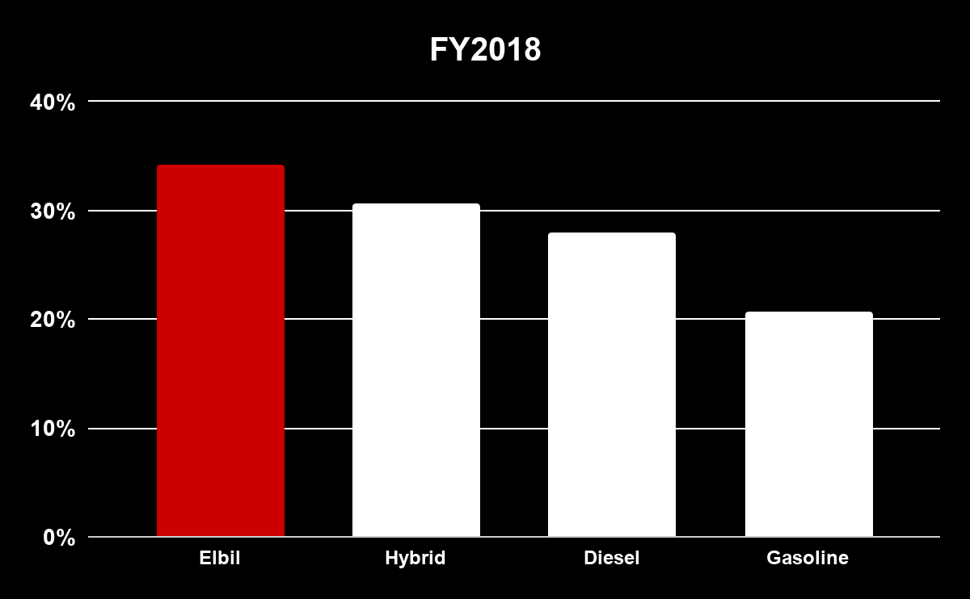
Reasons for the high claims frequency on electric vehicles
The claim frequency is higher for electric vehicles compared to other engine types
1
Immediate acceleration
2
Technology reduces
the drivers attention
3
Autopilot and automatic parking makes the driver inattentive
4
Low engine noise
*Numbers adjusted for geographical differences
Source: Opplysningsrådet for veitrafikken
PwC Digital Services
Confidential information for the sole benefit and use of PwC’s client.

Slide 15
Geographical differences in claim frequency - 50% of electric vehicles in Oslo have been involved in accidents. In Finmark the claim frequency on electric vehicles is lower than for other vehicles
Finnmark
EVs are mainly driven in the city due to..
Limited range on electric vehicles
Financial incentives (free toll passings)
Allowance to drive in bus lanes
Oslo

Slide 16
Differences by brand in claim frequency. Tesla is the only brand with fully electric vehicle fleet
Claim Frequency
20%
13%
Data on claim frequency from 2008-2018
Source: Opplysningsrådet for veitrafikken og Finans Norge

Slide 17
The introduction of electric vehicles to the market results in a more frequent need to update risk premium models
None or limited observations available to train machine learning models (e.g. GLM models) on new electric car brands impacts the possibility to accurately estimate risk premium for electric cars.
New observations should therefore continuously be included in the risk premium models to improve the models performance.
“The average repair costs is 35% higher for EVs compared to fossil vehicles”
Source: Protector Insurance
“It is more expensive to fix more advanced cars with a lot of new technology and screens, and to repair electric engines”
Source: Gjensidige Insurance

Slide 18
Electric cars - Ireland
*By March 31, 2019 (Source: Motorvognregisteret and OFV)

Slide 19
Financial Incentives in Ireland for Electric Vehicles
1
Grants for new purchases in case list price exceeds €14,000 (grant is €2,000 - €5,000 depending on list price)
2
Relief from Vehicle Registration Tax (VRT)
3
Lowest band of Motor Tax (€120 / year vs. average of ~ €400 / year)
4
Reduced tolls (by 50% for electric cars and by 25% for hybrids)
5
Free public chargers (about 1,100 in 2019) and grant available to establish a home charger (€600)

Slide 20
Reality - low current sales volumes but exponential growth
Total number of EVs at end 2018 was 4,825 but expected to almost to almost double in 2019.
New EV sales are shown in the table below.
Year | 2015 | 2016 | 2017 | 2018 | 2019 H1
Total EV registrations | 466 | 392 | 622 | 1,233 | 1,954
% of total new registrations | n/a | n/a | 0.5% | 1.0% | 2.4%

Slide 21
Government initiatives to increase prevalence by 2030
In its Climate Action Plan, the government puts a large focus on getting people to switch to electric cars in order to reduce emissions from transport.
One of the key actions of the plan is to accelerate the take up of EV (electric vehicle) cars and vans so that we reach 100% of all new cars and vans being EVs by 2030.
The plan sets a target of 950,000 electric vehicles on Irish roads by 2030.

Slide 22
Repeatedly revised targets for 2020
Caution needed for 2030 targets as those for 2020 have been revised and tumbled due lower actual sales vs. projected.
Targets for electric vehicles on the Irish roads by 2020:
240,000 (2008) / 10% of vehicle fleet
50,000 (2014)
20,000 (2017)
10,000 (2019)

Slide 23
Barriers to growth of EV fleet in Ireland
1
Issues with infrastructure - significant proportion of public chargers out of service (and takes months to repair), low number of fast charging points per 100km (IE: 21, NO: 619*)
2
Limited supply of affordable range - difficult for Irish distributors to to secure current limited demand
3
Limited financing options - lack of competitive rates for EVs due to fear of big hit on residual in near future due to advances in technology
4
Less pressure on air quality compared to other countries (e.g. diesel cars banned in the past from Oslo due to poor air quality)
*Source: European Alternative Fuels Observatory, www.eafo.eu

Slide 24
Summary of trends
Number of EVs expected to grow in Ireland dramatically in the future due to similar drivers as in Norway:
Financial incentives, grants
Lower running costs (fuel, tolls)
Lower motor tax
Growing awareness of climate change
Barriers in Ireland resulting in lower sales volumes:
Issues around infrastructure
Lack of affordable range
Limited competitive financing
Pace of growth uncertain due to offsetting impacts.

Slide 25
Potential challenges for motor pricing
Uncertainty around pace of growth and advances in technology present the following challenge to motor pricing for EVs:
Limited historic data (e.g. cost of repairs, residual value)
Potential for rapid volume change and emerging trends
Car insurance considered high compared to other countries
Especially for young drivers most likely to be interested in purchasing electric cars
Competitive, price sensitive market

Slide 26
Pricing automation using
machine learning

Slide 27
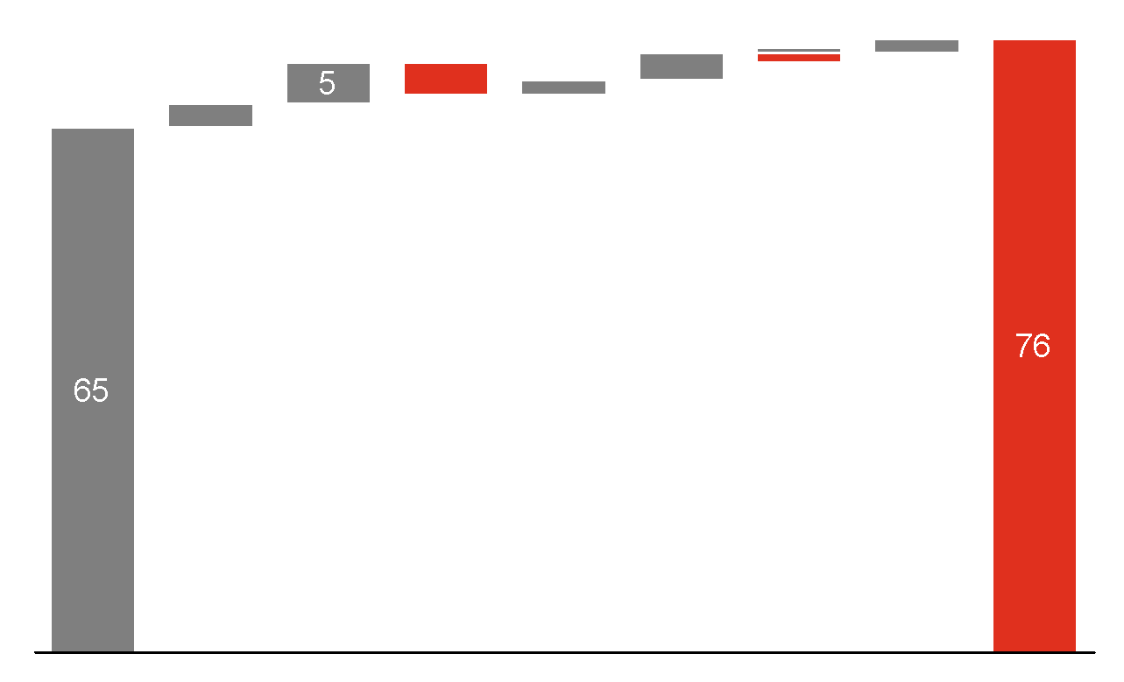
Continuously estimation of an accurate risk premium
Technical premium
Price optimization
Price to customer
Discounts
New Customer
Profit margin
Existing Customer
Market optimisation
Competitors
Marketing
Geography
Products and coverages
Individual price optimisation
Customer segment
Claims history
Channels
Risk premium
Adm. cost
Reinsurance
Capital cost
Provision
UW-factor
Capital income
CAT/unsyst. risk
Level regulation
Technical premium
Profitability vs growth

Slide 28
Use of advanced technology to speed up the pricing and underwriting process
Time to market
Enabling insurers to take their models faster to market
Automation
Transforming pricing process into a more efficient and automated process using the latest tools
New Technology
Insurers can test out new technology and gain valuable experiences, for instance open-source tools, cloud based solutions and machine learning
Increase profitability
By leveraging both existing data and new data sources, insures can better understand risk drivers and new emerging trends

Slide 29
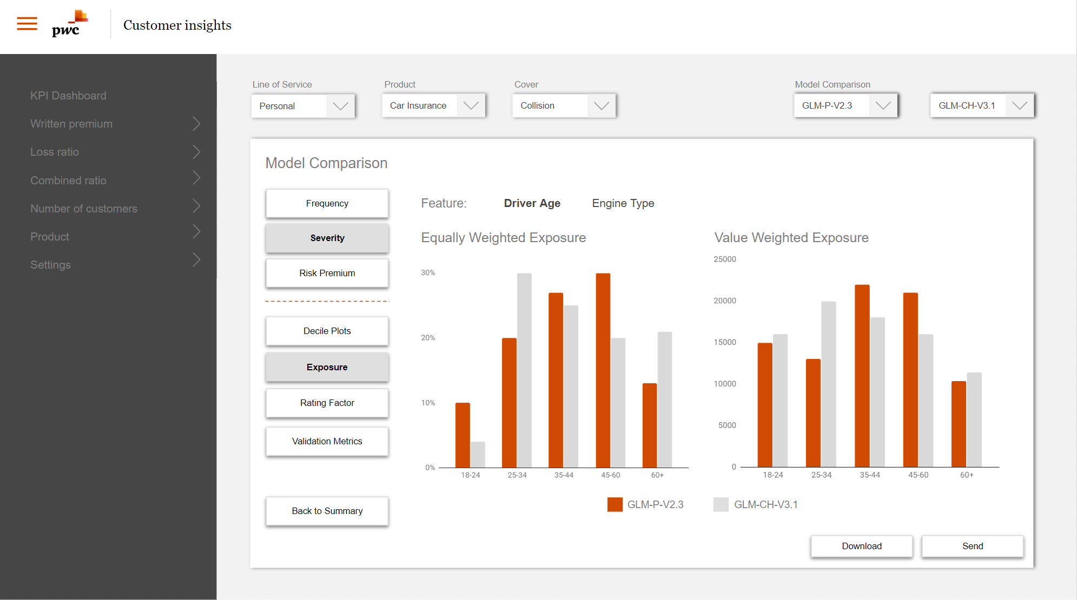
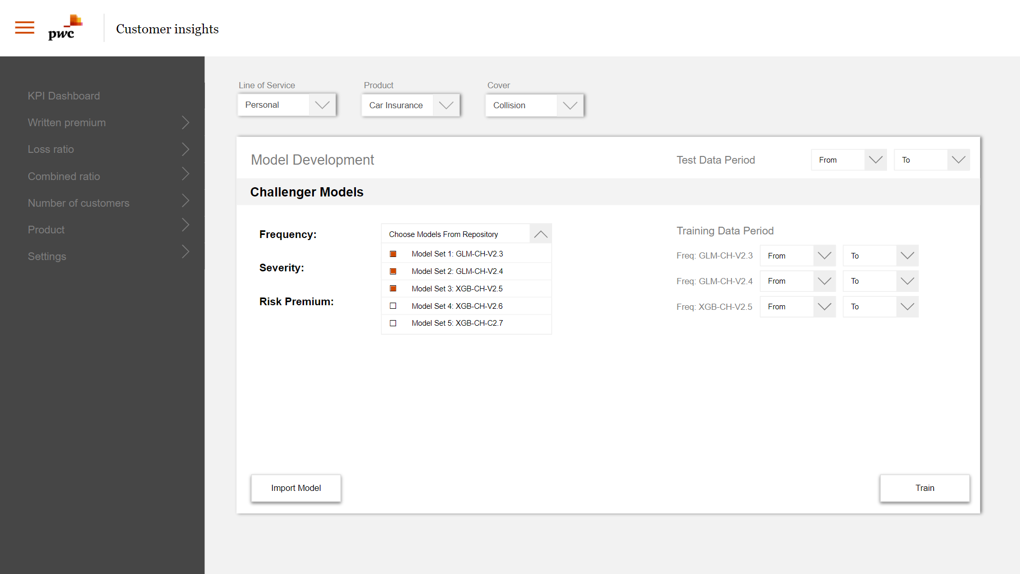
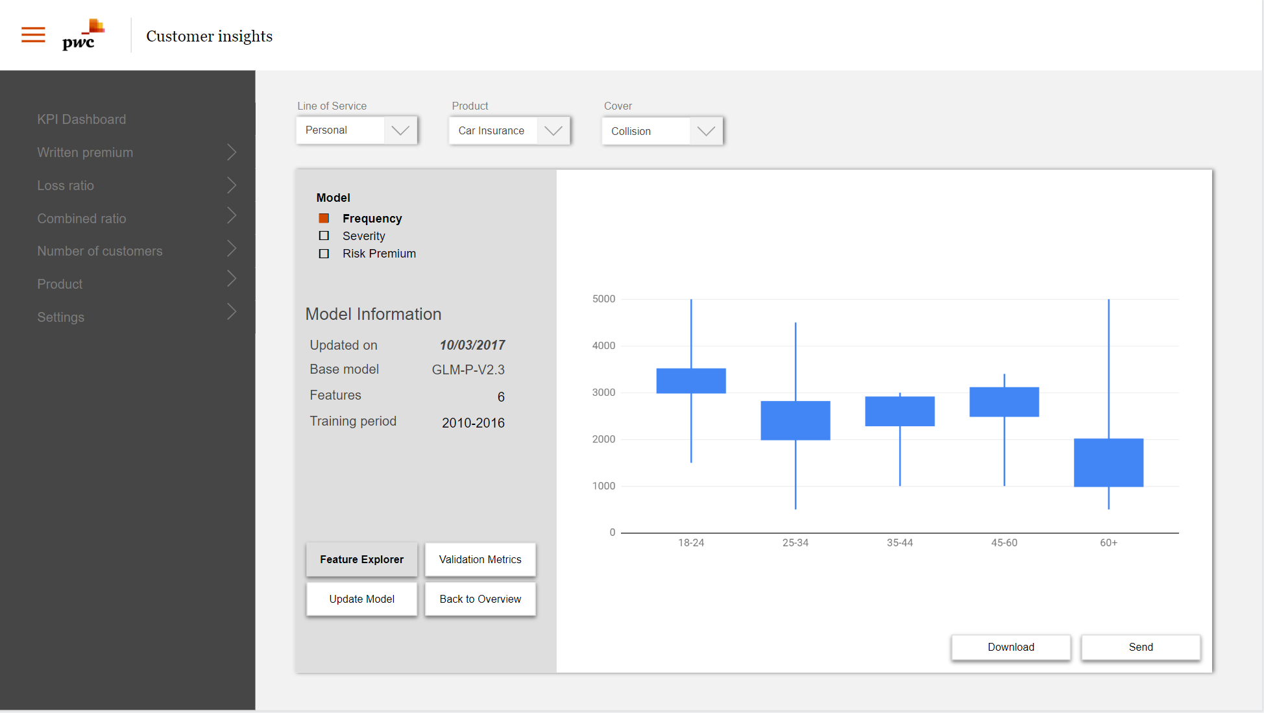
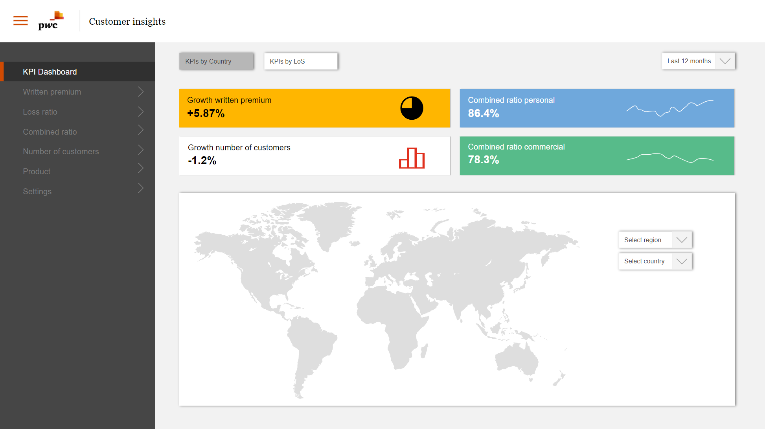
Structuring, standardising and automating is the way to go...
Visualise
A interactive dashboard will be giving insight into performance of coverages and business rules could be set to give notifications on underperforming models
Use machine learning
Different machine learning algorithms helps identify new risk drivers and interactions - in addition it facilitates taking advantage of new data sources and big data
Work together
The tool encourages both data scientists, actuaries and management to understand price models and their performance, resulting in increased organizational collaboration
Have good governance
Model governance framework provides the insurer with a full overview over the models that have been in production at any time, a key element to manage the complexity of being data driven
Always challenge
Having challenger models continuously competing with the models in production, pushes the organisation to always get better
Deploy in the cloud
A cloud based sandbox allows insurers to experiment with deploying models into production aside from legacy systems, reducing complexity and time to market

Slide 30
We leverage on pricing capabilities by implementing a structured and automated pricing process
CIP PLATFORM
Data
Analytics applications
Production
1
2
3
Collect, structure and make data accessible for pricing
Develop, validate, select and deploy pricing models
Manage tariffs in production
Development
Validation
Pricing
Target data model
APIs
Internal data sources
Selection
Governance
Integration with other systems
Deployment
External 3rd party data
Visualisation
Business Intelligence
Dashboards
Monitoring
Automated and efficient pricing process
Cloud based
Machine Learning
Big Data
IoT
APIs

Slide 31
The analytics platform covers the current and future needs for developing, validating, and selecting the best performing machine learning (ML) models
Analytics platform
Development
Validation
Selection
Model deployment
Full flexibility on the choice of machine learning (ML) algorithm
Standardised tests are run for each developed model
Compare production models (champions) with new models (challengers)
The ML models are ordered based on the validation results
Visual indicators help choosing the right model for deployment
There are effective ways of deploying models in production (e.g. API)
Should be able to manage live data
GLM
1
Predictive ability
Random Forest
Ranking ability
2
RMSE
AIC
MAE
#
3
Stability
xgBoost
Random forest
1
GLM
2
xgBoost
3
Neural net
4
Neural networks

Slide 32
Lessons learned during other pricing projects
Proof of Concepts are very valuable to understand what an insurer wants
Own developed pricing algorithms (e.g. in R) cost a lot of time
For example a PoC with Guidewire Predictive Analytics
Conclusion: very powerful cloud tool for running ML algorithms, but expensive and still work-arounds needed (not complete)
We often hear “we have our own data scientists”, but time to market is slow, key person risk and high maintenance costs
Clients are always open to hear a story about new (pricing) tools
New pricing tools need involvement of many stakeholders
Positive response on our pricing proposition from clients so far
Not only an actuarial sandbox, but also involvement needed from COO, product managers, IT, marketing, legal etc.

Slide 33
Flexibility is key to enable application of customer analytics and dynamic pricing
Champion/challenger framework
Risk premium models
Dynamic Pricing
Optimization algorithm that finds the optimal price
Churn models
Acceptance models
Customer segmentation model
Customer-/product profitability models
Price elasticity curve
Risk Based Pricing
Price to customer that reflects underlying risk, relevant costs and required profit margin
Price new policy
Policy renewal
Customer analytics
probability that a customer accepts an offer at given price

Slide 34
Demo of prototype
Link to demo

Slide 35
Demo of pricing software
Videos only visible in “Slide Show” mode, see button on at the bottom right corner.
Video 1
Video 3
Visualization
Output
Client IT systems
Structured data
Select models and data for training
Train models
Validate models
Rank assessment
Video 2
Model development
Model Repository
Model specification
Validation results
Ranking algorithm
Model Governance
Video 4
Front end
Sandbox
Notes:
Teknisk skisse av løsning og neste side gjensidige + utfordringer

Slide 36
Proposed approach

Slide 37
Our pricing tool can be used to accelerate price transformation for non-life insurers
Test a more innovative way to pricing
Get more familiar with new tools and software
A pilot is a great way of trying, failing and testing before committing to a larger project
Can be applied to both personal and commercial lines
In a pilot we typically introduce new tools for some insurers like R, Github, Microsoft Azure and Power BI
Deploy new models into production
Lower risks and costs
New models will be developed for the chosen product(s) and potentially set into production - resulting in a direct financial effect from the pilot
We propose a lightweight pilot that will reduce the possibility of failure and high IT-costs

Slide 38
An example of how insurers could deploy a pilot
1
3
5
Define scope and identify product(s) for pilot and benchmark assessment if applicable
Update and validate new vs existing risk premium models
Update remaining pricing elements if applicable
2
4
6 (optional)
Extract data to be applied in pilot (delivered by client)
Assess model performance and replace old models if applicable
Apply sandbox solution to test new ways of setting pricing models into production
Pilot length: 4-6 weeks

Slide 39
Thank you!
Contact us
Jan-Magnus Moberg
Director PwC Norway
Adjunct Professor NHH
jan.moberg@pwc.com
+47 952-60649
Bence Zaupper
Senior Manager PwC Ireland
bence.zaupper@pwc.com
+353 87 199-3201
© 2019 PwC. All rights reserved. Not for further distribution without the permission of PwC. “PwC” refers to the network of member firms of PricewaterhouseCoopers International Limited (PwCIL), or, as the context requires, individual member firms of the PwC network. Each member firm is a separate legal entity and does not act as agent of PwCIL or any other member firm. PwCIL does not provide any services to clients. PwCIL is not responsible or liable for the acts or omissions of any of its member firms nor can it control the exercise of their professional judgment or bind them in any way. No member firm is responsible or liable for the acts or omissions of any other member firm nor can it control the exercise of another member firm’s professional judgment or bind another member firm or PwCIL in any way.

